Slide 1


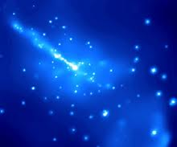
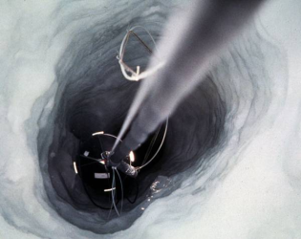
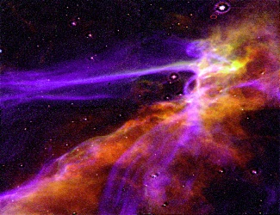
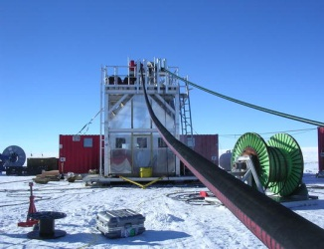
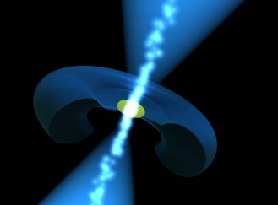
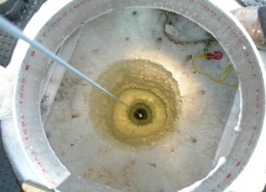
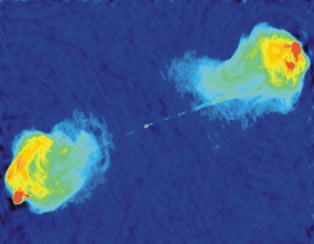
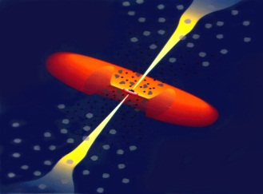
IceCube: Ultra-high Energy Neutrinos
Aya Ishihara
JSPS Research Fellow at Chiba University
for the IceCube collaboration
Neutrino2012 at Kyoto June 8th 2012

Slide 2
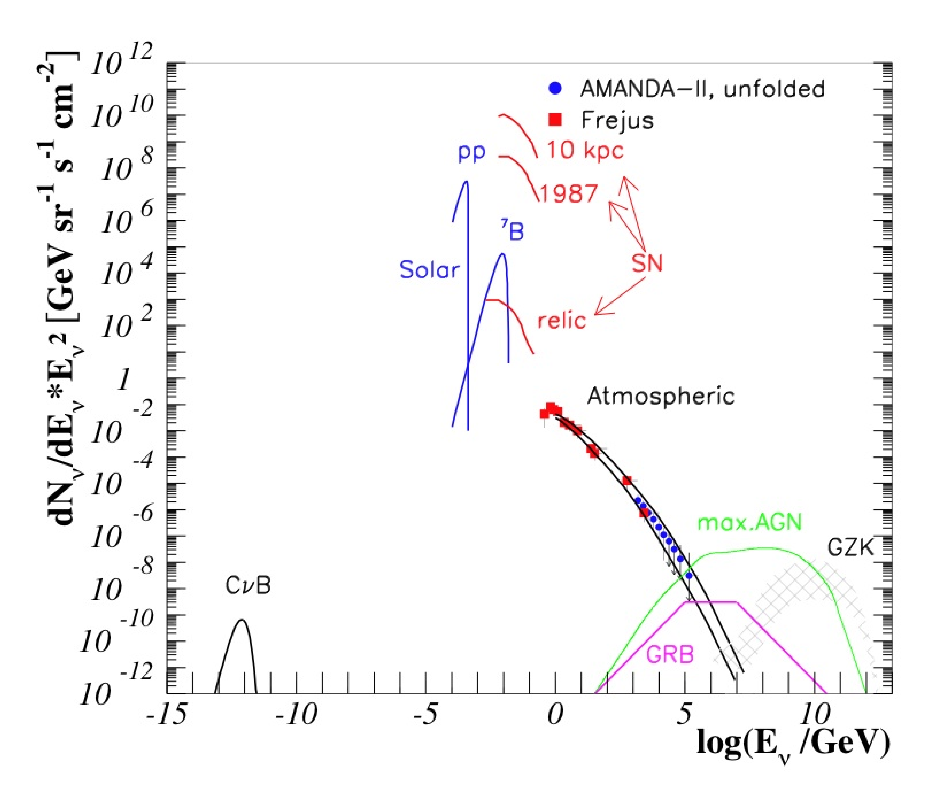
Ultra-high Energy Neutrinos: PeV and above
Energies above dominant atmospheric neutrinos
Cosmic frontier - PeV gamma-ray horizon limited to a few tens of kpc (our galaxy radius)
Cosmogneic neutrino production is a ‘guaranteed’ ν source

Slide 3
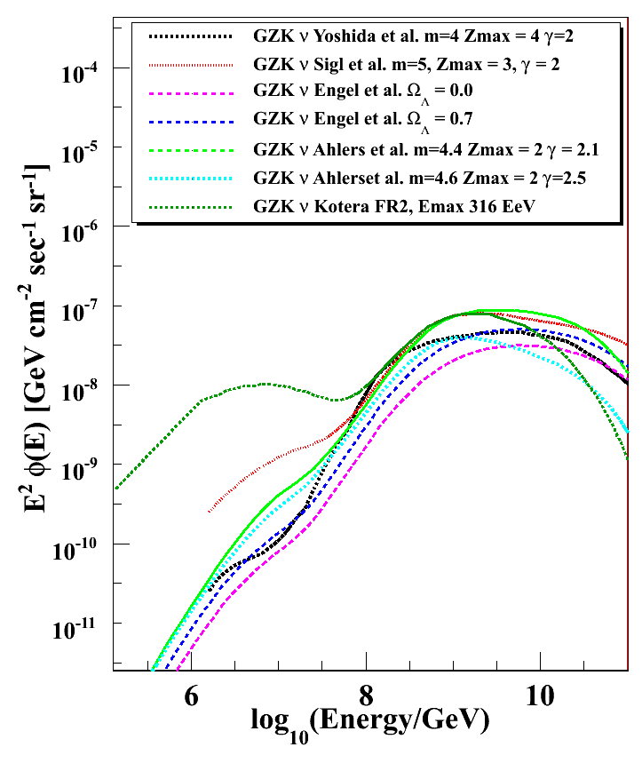
The highest energy neutrinos
cosmogenic neutrinos induced by the interactions of cosmic-ray and CMB photons
Off-Source (<50Mpc) astrophysical neutrino production via GZK mechanism
p >100EeV
ν_{μ}
ν_{μ}
The main energy range: E_{ν} ~ 10⁸⁻¹⁰ GeV
π⁺
ν_{e}
π⁰
μ⁺
e⁺
Carries important physics
Location of the cosmic-ray sources
Cosmological evolution of the cosmic-ray sources
Cosmic-ray spectra at sources
The highest energy of the cosmc-rays
Composition of the cosmic-rays
Particle physics beyond the energies accelerators can reach
Various
GZK ν
models

Slide 4
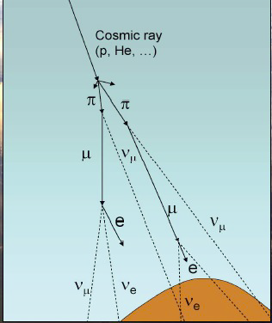
Atmospheric neutrinos in PeV
Conventional atmospheric neutrinos from decays of pion and kaons
Prompt atmospheric neutrinos form decays of heavy flavor short lived mesons (charm, bottom)
Prompt harder than conventional still steeper than astronomical spectra
Transition around 3 x 10⁵ GeV depending on the models
Prompt Slope = 2.7
Conventional Slope = 3.7
Physics of heavy flavor particle production

Slide 5
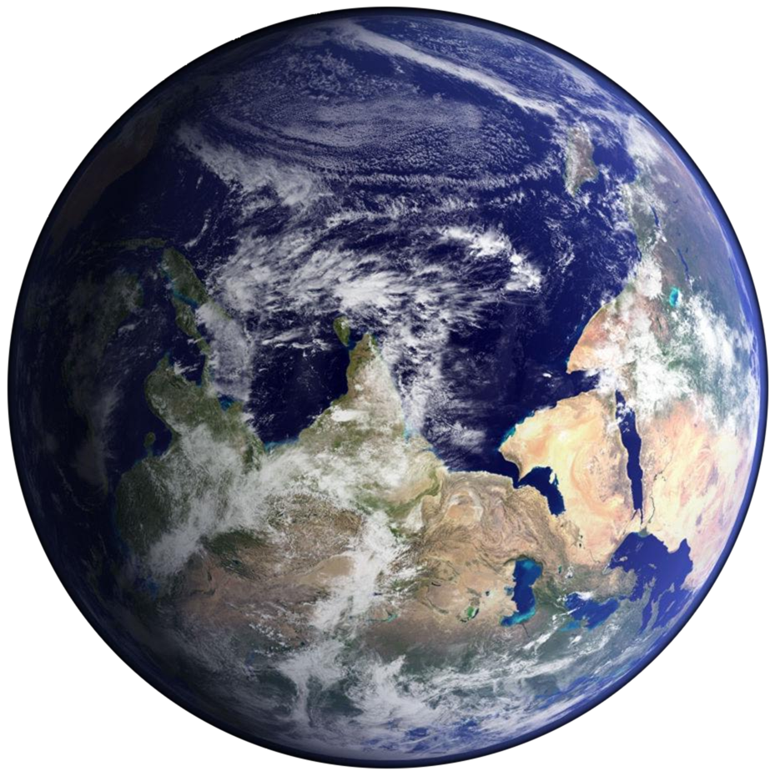
UHE Neutrinos In the Earth…
down-going
cosθ _{ZA}~ 1
CR
Generally neutrinos identified as “through the Earth” up-going events
Earth is opaque for UHE neutrinos
UHE neutrino-induced events are coming from above and near horizontal direction
μ
UHE ν
μ
μ,τ
μ,τ
e,μ
τ
North
ν_{γ}
τ
μ
UHE neutrino mean free path
λ_{n} ~ 100 km << R_{Earth}
σ^{cc}_{nN} ~ 10^{-6~-4} mb
ν_{γ}
ν_{e,μ}
> PeV
up-going
cosθ _{ZA}~ -1
ν_{e,μ} < 1PeV

Slide 6
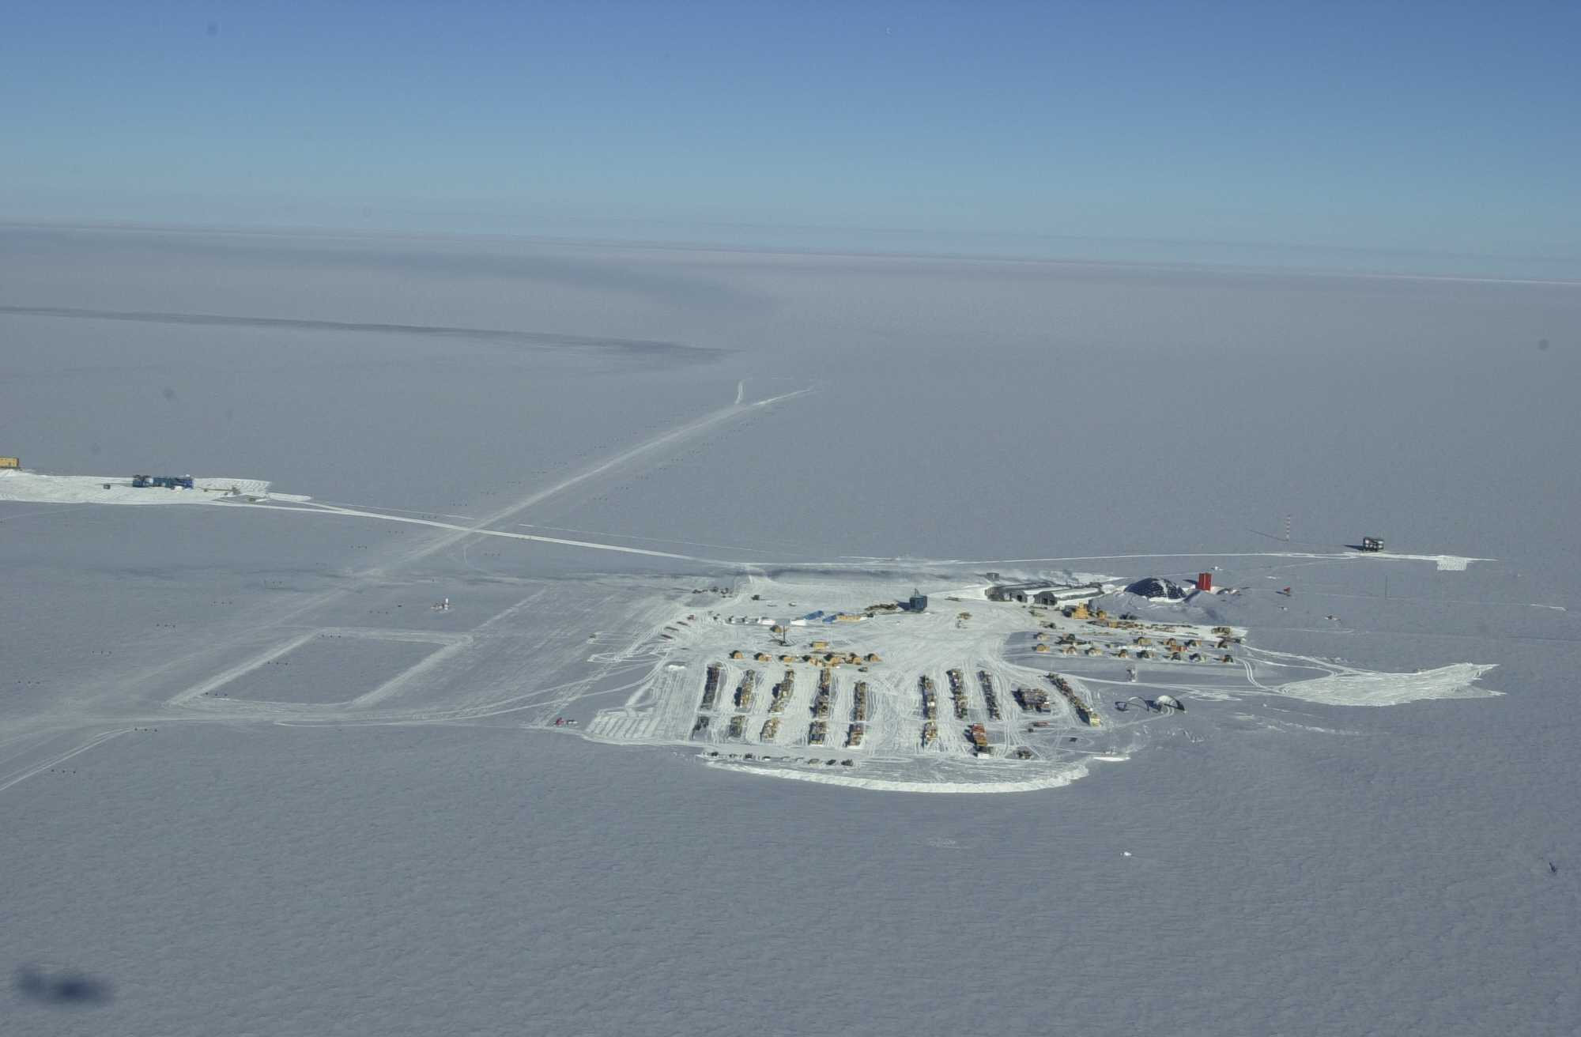
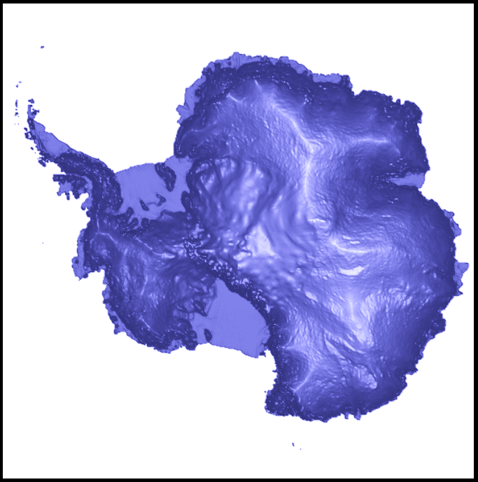
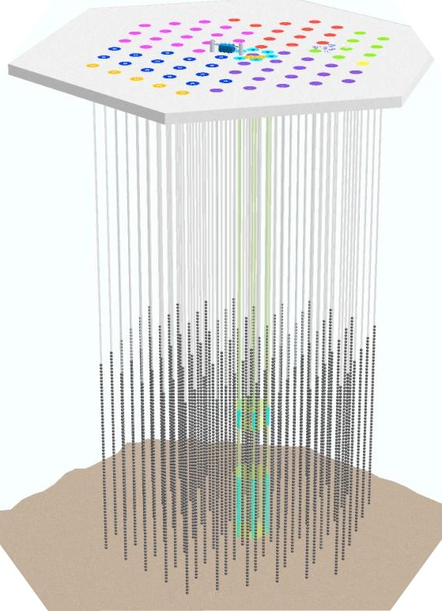
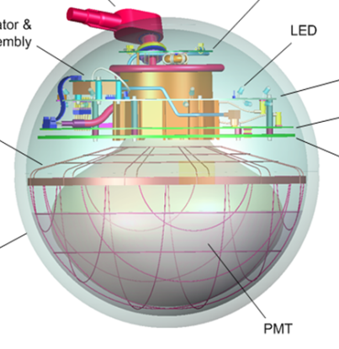
The IceCube Detector
1km
South Pole
1.5km
Array of 80 sparse and 6 dense strings
Dome (old station)
5160
optical
sensors
Amundsen-Scott South Pole station
1km

Slide 7
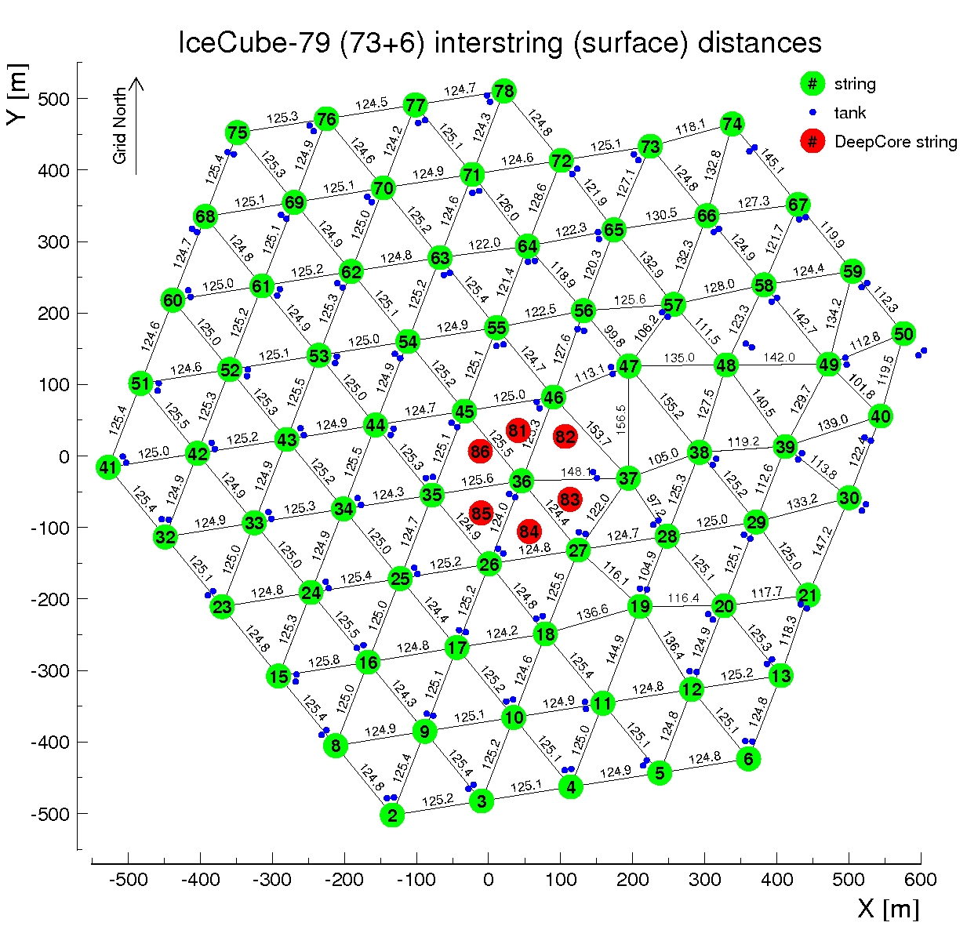
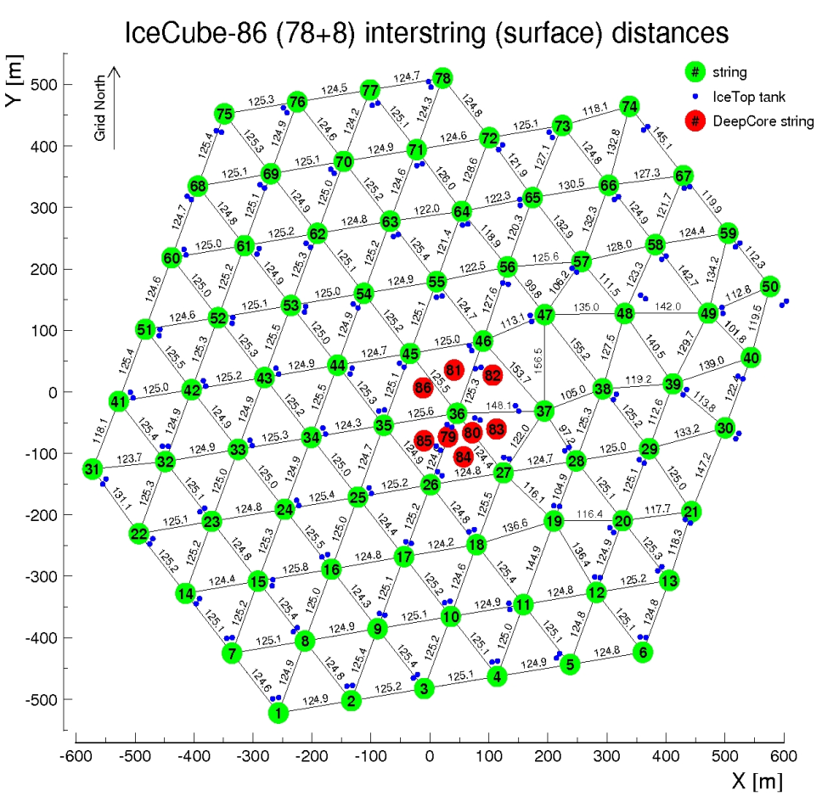
Data samples
9 strings (2006)
22 strings (2007)
40 strings (2008)
59 strings (2009)
79 strings (2010)
86 strings (2011)
Effective livetime of 672.7days
2010-2011 - 79 strings config.
May/31/2010-May/12/2011
Effective livetime 319.07days
2011-2012 – 86 strings config
May/13/2011-May14/2012
Effective livetime 353.67 days
IceCube Top View
IceCube Top View
new strings
IceCube has been in a stable operation for more than 5 years

Slide 8
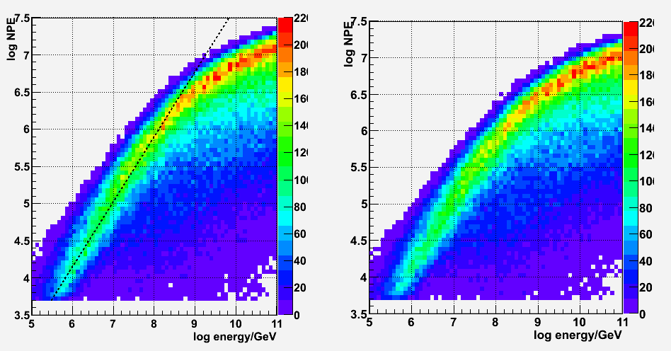
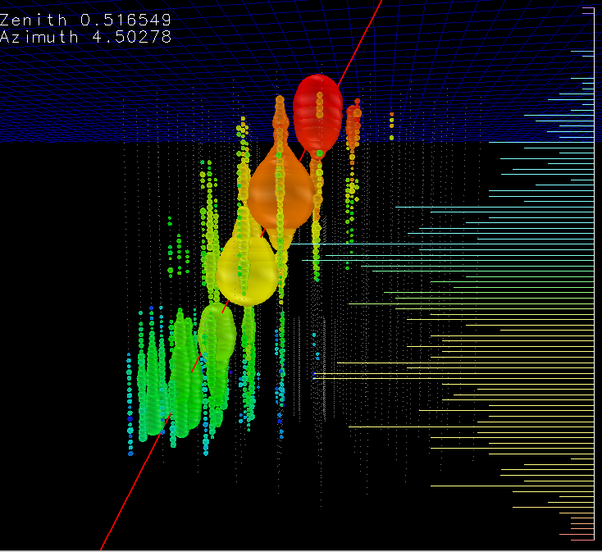
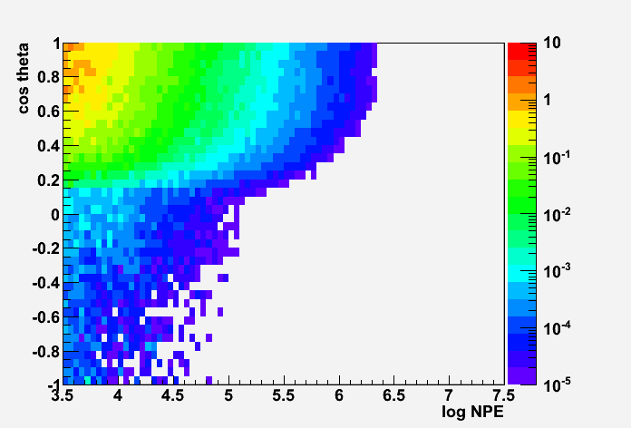
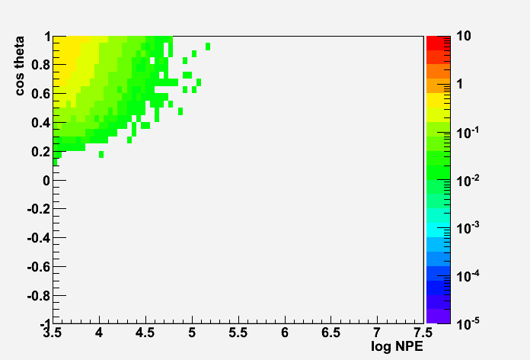
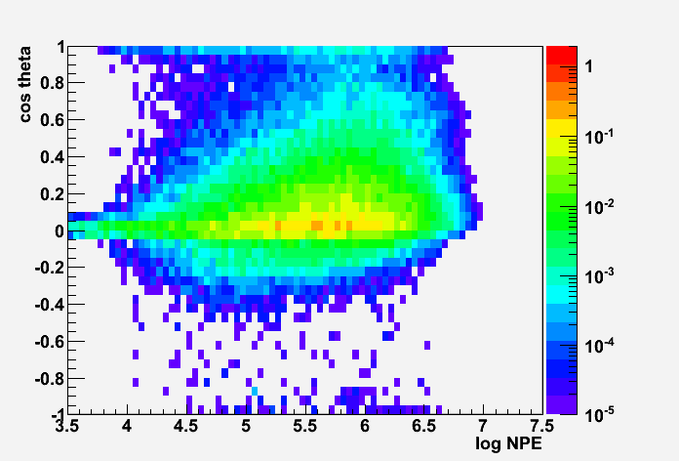

The Event Selection
channel # > 300
Energy of incoming particle $∝E$nergy-losses in detector $∝$ number of photo electrons (NPE)
Optimization based MC / MC verification based on 10% experimental ‘burn’ sample
Background MC
Experimental Data (10%)
Signal MC
selection criteria
for 2011-2012
\
1.0 ~ 30/livetime
Background
0.144/livetime
See the details of 2010-2011 data analysis: Poster #12-3 (Keiichi Mase)

Slide 9
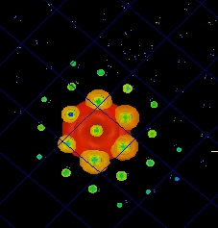
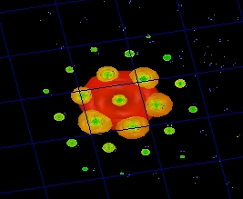
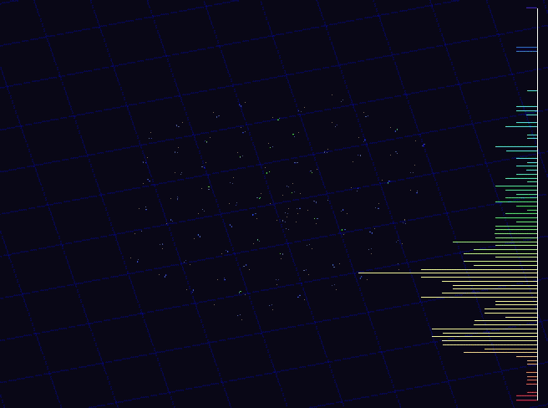
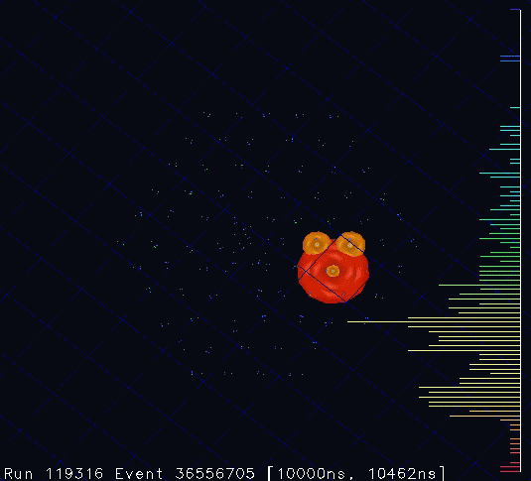
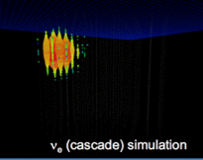
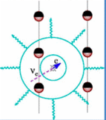
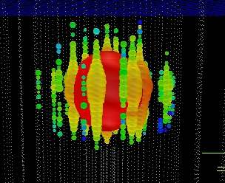
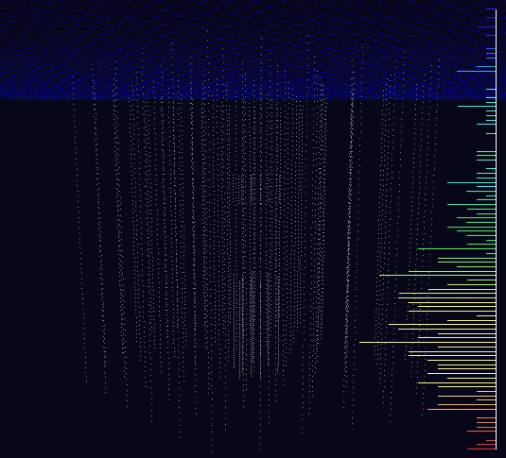
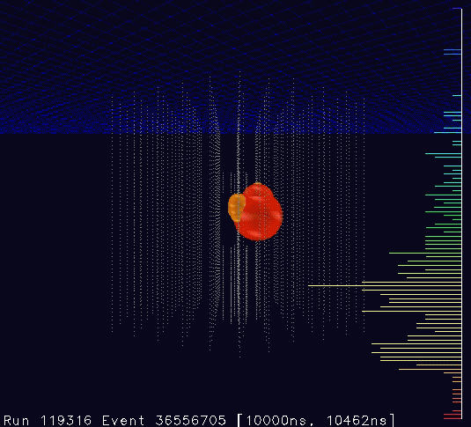
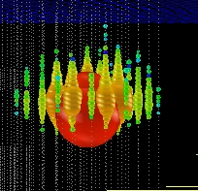
Two events passed the selection criteria
2 events / 672.7 days (background expectation 0.14 events)
preliminary p-value: 0.0094 (2.36σ)
Run119316-Event36556705
Jan 3rd 2012
NPE 9.628x10⁴
Number of Optical Sensors 312
Run118545-Event63733662
August 9th 2012
NPE 6.9928x10⁴
Number of Optical Sensors 354
CC/NC interactions in the detector
MC

Slide 10
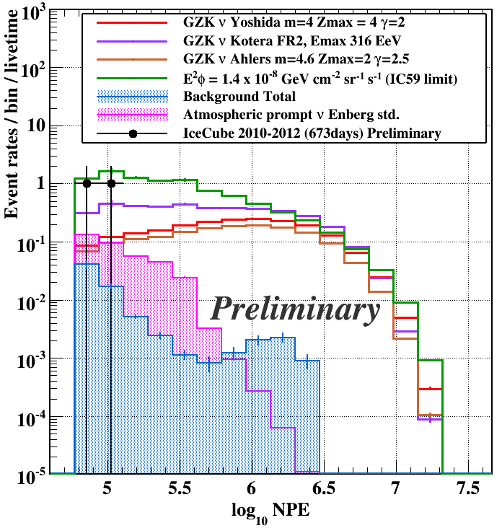
Event Brightness (NPE) Distributions 2010-2012
Observed 2 high NPE events near the NPE threshold
No indication
that they are instrumental artifacts
that they are cosmic0ray muon induced
Possibility of the origin includes
cosmogenic ν
on-site ν production from the cosmic-ray accelerators
atmospheric prompt ν
atmospheric conventional ν

Slide 11
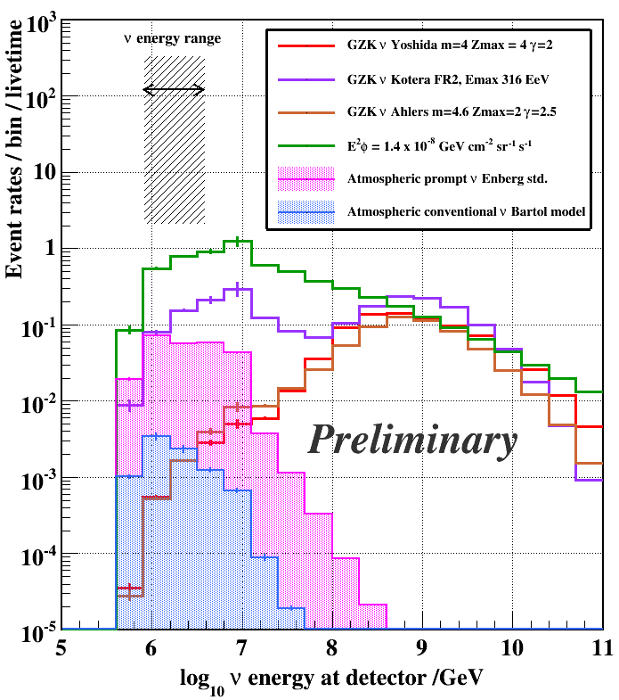
Neutrino Energy Distributions (2010-2012)
energy distributions of neutrinos reaching to the IceCube depth
EM+hardronic (CC) or hadronic (NC) cascade energy ~ PeV
Most likely to be PeV to 10 PeV neutrinos
The highest energy neutrino events observed ever!

Slide 12
Expected Numbers of UHE Events
Models | IceCube 2008-2009 Phys. Rev D83 092003 (2011) 333days | IceCube 2010-2012 per 672.7days
 |  | E^{detector} < 10⁸ GeV and interaction in detector | All contributions
Atmos. prompt ν (Enberg std.)^ |  | 0.3 | 0.4
IC59 diffuse limit ^^ E²φ = 1.4 x 10⁻⁸GeV cm⁻² sr⁻¹ sec⁻¹ |  | 5.0 | 9.1
Background (atm. ν + atm. μ) | 0.11 | 0.01 | 0.14
Experimental data | 0 | 2 | 2
GZK (Yoshida m=4)* | 0.57 | 0.4 | 2.1
GZK (Ahlers max) ** | 0.89 | 0.5 | 3.2
GZK (Ahlers best fit) ** | 0.43 | 0.3 | 1.6
GZK (Kotera, dip FRII) *** |  | 1.7 | 4.1
GZK (Kotera, dip SFR1)*** |  | 0.6 | 1.0
Preliminary
*Yoshida et al The ApJ 479 547-559 (1997), **Ahlers et al, Astropart. Phys. 34 106-115 (2010, ***Kotera et al, ^R. Enberg, M.H. Reno, and I. Sarcevic, Phys. Rev. D 78, 043005 (2008), ^^ Talk G. Sullivan This conference

Slide 13
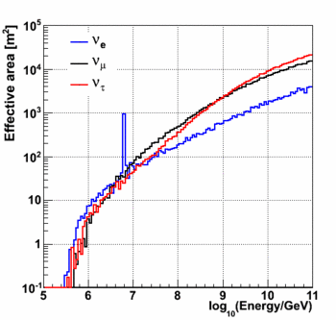
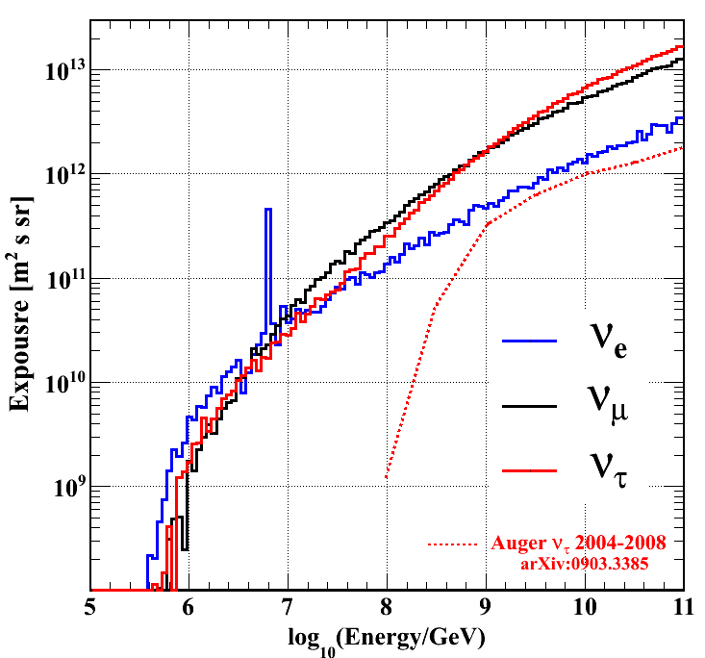
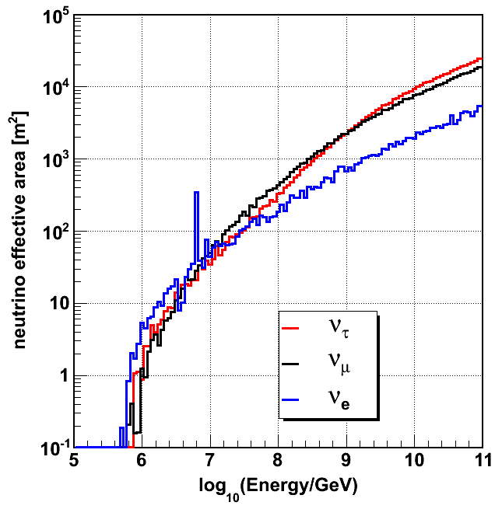
The Exposure and Effective Area
Effective Areas
IceCube UHE 2 Years Exposure (2010-2012)
Preliminary
IC79 Preliminary
(2010-2011)
IC86 Preliminary
(2011-2012)
Exposure [m² sec sr]

Slide 14
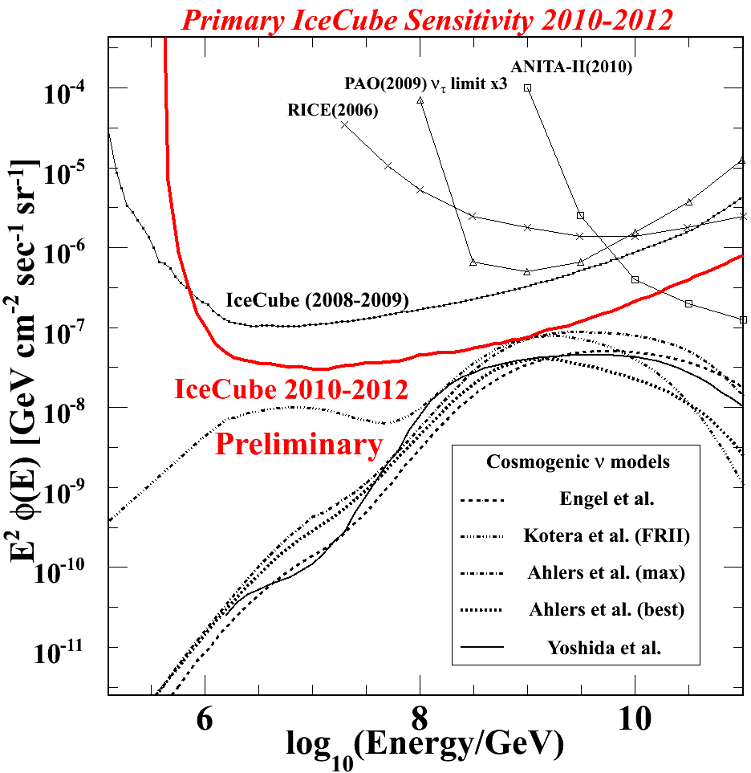
IceCube UHE Sensitivity 2010-2012
Significantly improved from the previous IceCube results
The world’s best sensitivity!
Will constrain (or detect) the neutrino fluxes down to mid-strong cosmological evolution models

Slide 15
Summary
Searched for neutrinos with PeV and greater energies in nearly full 2 years of the IceCube data
Two candidate events observed
PeV to 10PeV energy cascade-channel neutrino events (CC/NC interactions within the detector)
The highest energy events observed ever!
Likely to be beyond the conventional atmospheric neutrinos
Hints for the PeV events origin from different energy-region / channels are also coming soon!
More cascade event sensitive analysis
Lower energy regions for the spectral transition
Statistical confirmation foreseen with an independent sample
We are into very interesting era of neutrino astrophysics!

Slide 16
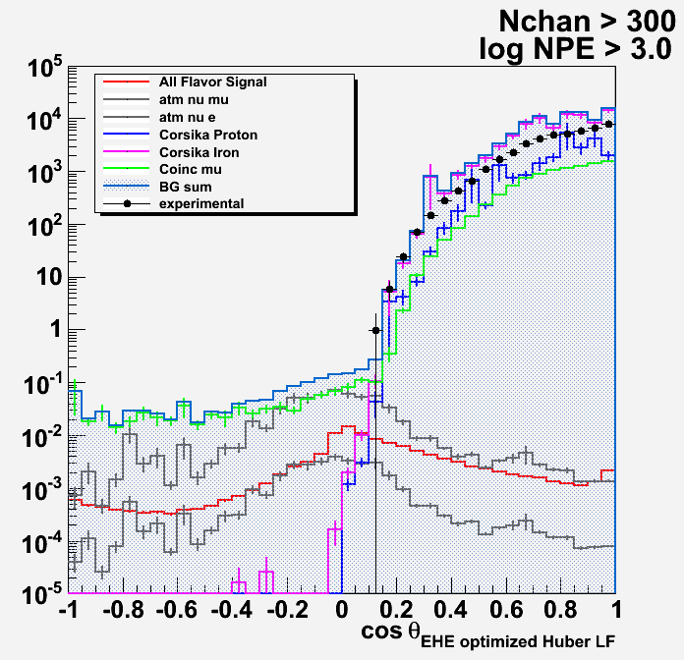
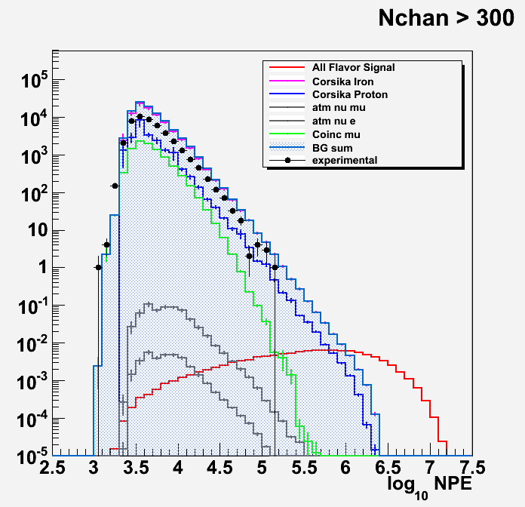
Backup
NPE and cos zenigh angle distributions comparisons with burn sample

Slide 17
Passing rates (stat. errors only)
Passing rates (per burn sample live time of 498.350 hours ) table
 | Experimental | Atm mu SIBYLL Fe | Coincident muon | atmospheric neutrinos | Atm mu SIBYLL H | Signal
Filter Online | 3539908 (1.973Hz)
Filter Offline (NPE > 1000, Nch > 50) | 1.615 x10⁶ | 2.34+/-0.08 x10⁶ | 2.881+/-0.005 x10⁵ | 163.2+/-3.0 | 9.85+/-1.3 x10⁵ | 0.1528+/-0.0006
(NPE > 1000, Nch > 300) | 44458 | 8.37+/-0.49 x10⁴ | 9.48+/-0.03 x10³ | 0.648 +/- 0.032 | 2.16+/-0.34 x10⁴ | 0.1136+/-0.0004
(NPE > 10^3.5, Nch > 300) | 34411 | 6.85+/-0.40 x10⁴ | 7655.0+/-23.0 | 0.625+/-0.031 | 1.75+/-0.32 x10⁴ | 0.1133+/-0.0004
(NPE > 10^4.0, Nch > 300) | 3019 | 5.65 +/- 0.271 x10³ | 558.7+/-3.4 | 0.185+/-0.011 | 631.72+/-59.61 | 0.1102+/-0.0004
(NPE > 10^4.5, Nch > 300) | 134 | 253.4 +/- 13.9 | 9.53 +/- 0.20 | 0.0232 +/- 0.0013 | 27.7 +/- 2.2 | 0.1019+/-0.0004
Final criteria | 0.0 | 0.00059 +/- 0.00024 | 6.37e-07 +/- 4.50e-07 | 0.0028 +/- 0.0002 | 8.2e-05 +/- 5.7e-05 | 0.0645 +/- 0.0003

Slide 18
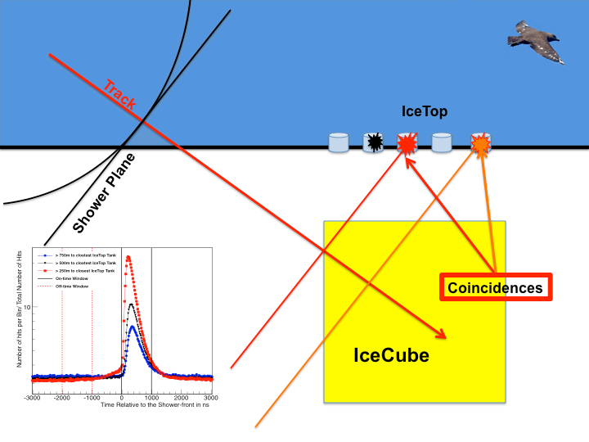
Near future improvement Background Veto with IceTop
Downward-going region is airshower induced muon background dominated
Background MC
Background
0.15/livetime
Signal MC
\
1.0 ~ 30/livetime
18

Slide 19
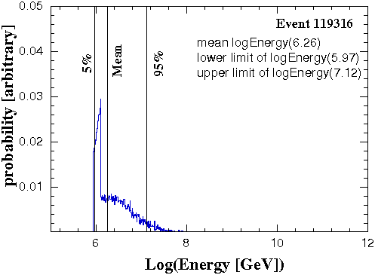
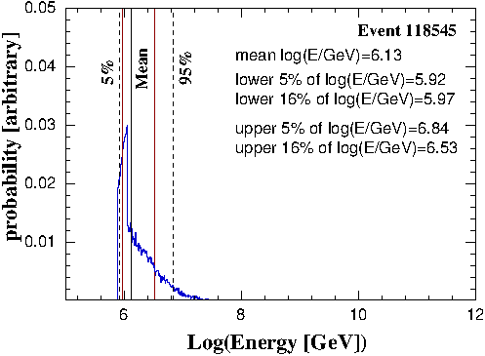
Neutrino energy estimation
preliminary
reconstructed
energy: 1.09 PeV
preliminary
reconstructed
energy : 975 TeV
A method of the cascade energy reconstruction
- Poisson likelihood for all pulses
- Analytic likelihood maximization for energy
- Numerical minimization (Gulliver) in x, y, z, time, zenith, azimuth

Slide 20
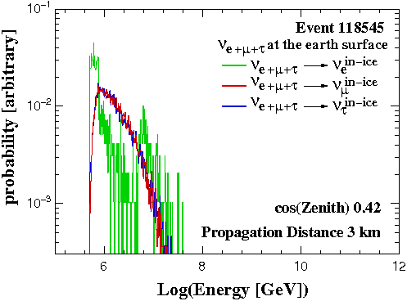
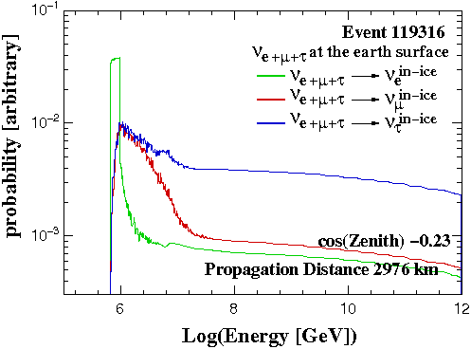
Surface Energy Distribution of Flavor Dependence
For the downward-going geometry difference due to different parent neutrino flavors on surface is small. For the upward-going geometry it is more relevant, still uncertainty extend not more than 1 energy decades.

Slide 21
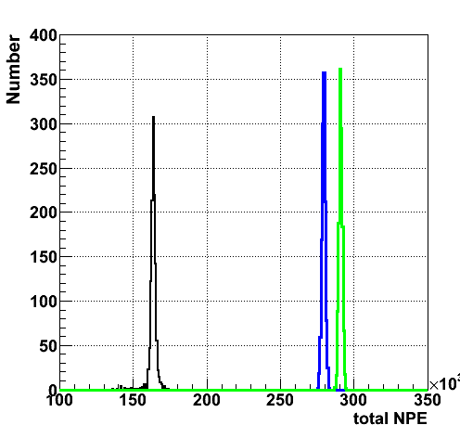
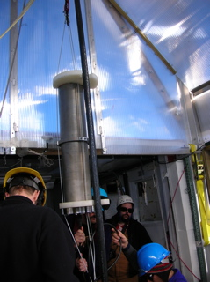
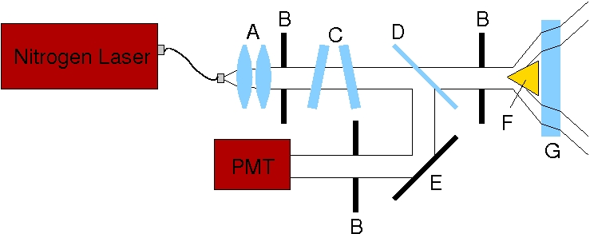
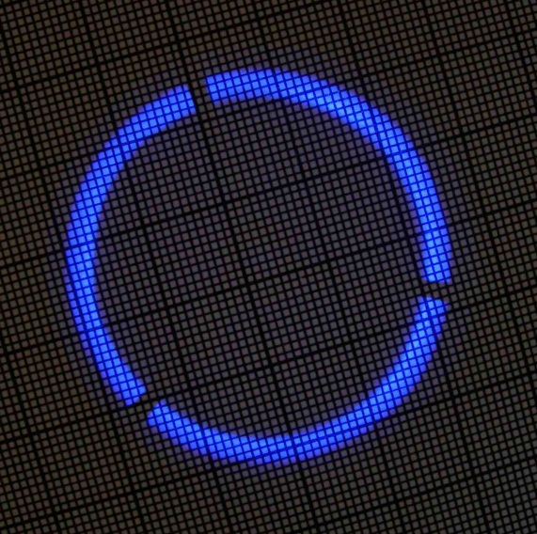

In-situ energy scale calibration
Calibrated light source: Standard Candle
in-situ calibrated N₂ pulsed laser
light wavelength 337 nm
at 100% intensity generates 4x10¹² photons per pulse emitted at 41º
output adjustable between 0.5% ~ 100%

