Slide 1
Future experiments
Albrecht Karle
University of Wisconsin-Madison
Neutrino 2012
Kyoto

Slide 2
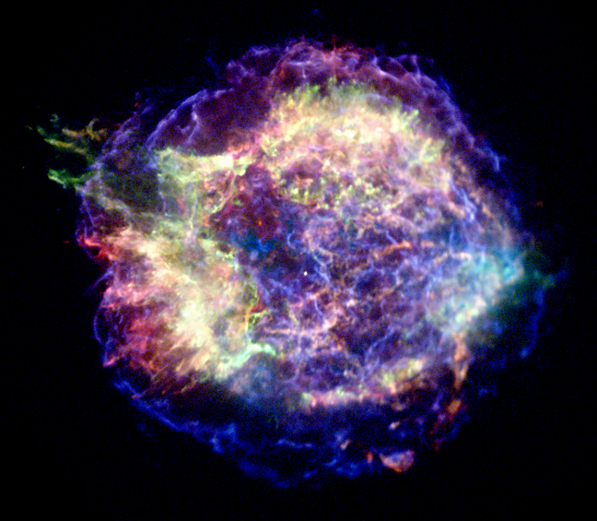
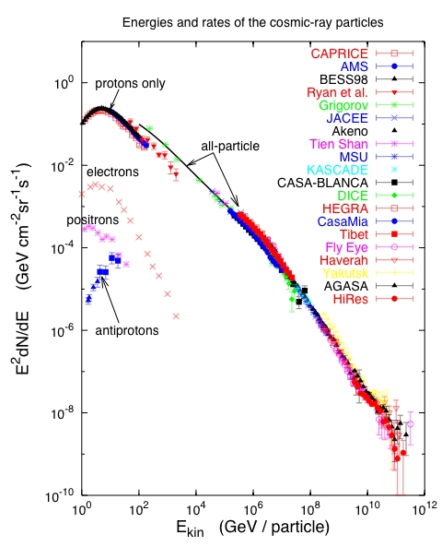
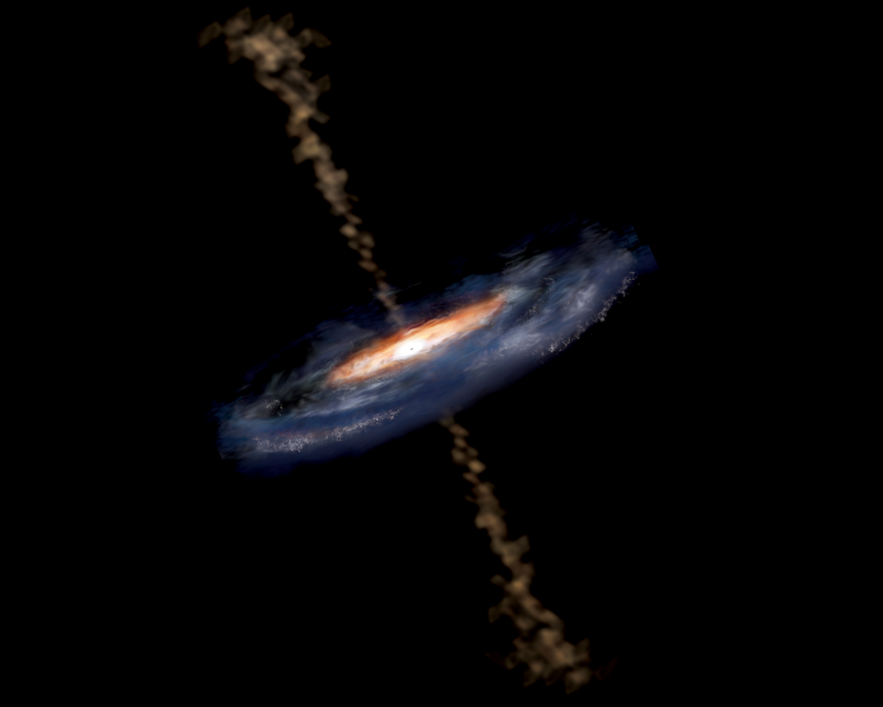
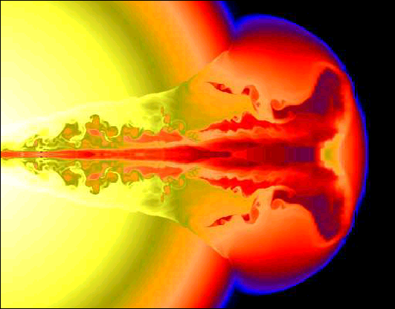
Cosmic Rays and Neutrino Sources I: neutrinos from accelerators
Cosmic rays
T. Gaisser 2005
  Cosmic ray interaction in accelerator region:
  SN remnants
  Active Galactic Nuclei
  Gamma Ray Bursts
knee
1 part m⁻² yr⁻¹
Ankle
1 part km⁻² yr⁻¹
Notes:
Cosmic rays have been observed to energies above 1E20eV. Spectrum and composition give some ideas of the nature of the acceleration and transport.
Most candidates of astrophysical neutrinos are closely related to the observation of high energy cosmic rays. We know that cosmic rays exist to highest energies. Possible sources are SN remnants, active galaxies or gamma ray bursts. Neutrino production may take place in the source region or on other, not too dense targets such as the Earth’s atmosphere, the interstellar medium or the cosmic microwave background.

Slide 3
Neutrino production from comic rays on known targets.
T. Gaisser 2005
T. Gaisser 2005
Known targets:
Earth’s atmosphere: Atmospheric neutrinos (from π and K decay)
Interstellar matter in Galactic plane: CR interacting with ISM, concentrated on the disk
Cosmic Microwave background: UHE cosmic rays interact with photons in interglactic photon fields.
Notes:
Cosmic rays have been observed to energies above 1E20eV. Spectrum and composition give some ideas of the nature of the acceleration and transport.
Most candidates of astrophysical neutrinos are closely related to the observation of high energy cosmic rays. We know that cosmic rays exist to highest energies. Possible sources are SN remnants, active galaxies or gamma ray bursts. Neutrino production may take place in the source region or on other, not too dense targets such as the Earth’s atmosphere, the interstellar medium or the cosmic microwave background.

Slide 4
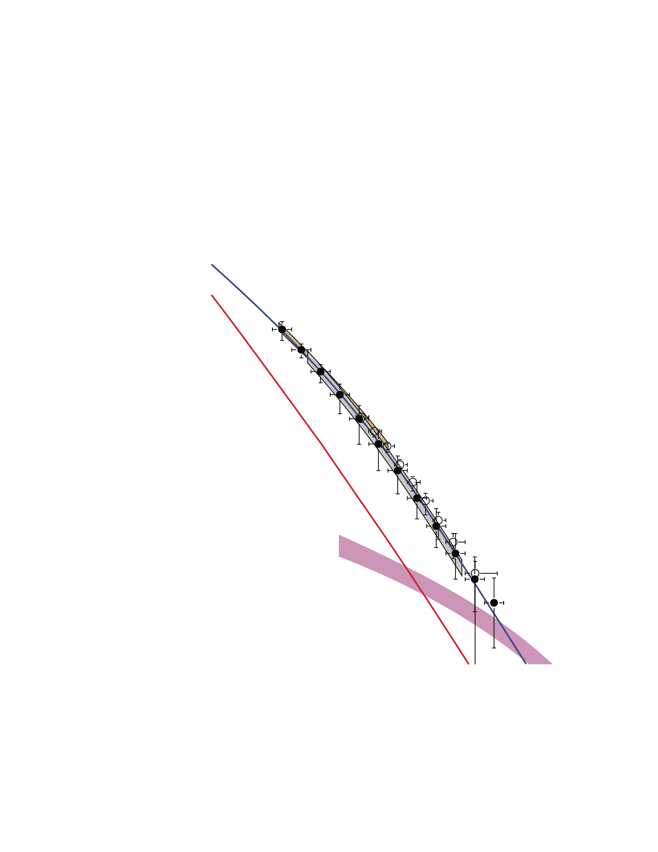
Neutrino production from comic rays on known targets.
T. Gaisser 2005
T. Gaisser 2005
Known targets:
Earth’s atmosphere: Atmospheric neutrinos (from π and K decay)
Interstellar matter in Galactic plane: CR interacting with ISM, concentrated on the disk
Cosmic Microwave background: UHE cosmic rays interact with photons in interglactic photon fields.
Notes:
Cosmic rays have been observed to energies above 1E20eV. Spectrum and composition give some ideas of the nature of the acceleration and transport.
Most candidates of astrophysical neutrinos are closely related to the observation of high energy cosmic rays. We know that cosmic rays exist to highest energies. Possible sources are SN remnants, active galaxies or gamma ray bursts. Neutrino production may take place in the source region or on other, not too dense targets such as the Earth’s atmosphere, the interstellar medium or the cosmic microwave background.

Slide 5
Neutrino production from comic rays on known targets.
T. Gaisser 2005
T. Gaisser 2005
Known targets:
Earth’s atmosphere: Atmospheric neutrinos (from π and K decay)
Interstellar matter in Galactic plane: CR interacting with ISM, concentrated on the disk
Cosmic Microwave background: UHE cosmic rays interact with photons in interglactic photon fields.
Notes:
Cosmic rays have been observed to energies above 1E20eV. Spectrum and composition give some ideas of the nature of the acceleration and transport.
Most candidates of astrophysical neutrinos are closely related to the observation of high energy cosmic rays. We know that cosmic rays exist to highest energies. Possible sources are SN remnants, active galaxies or gamma ray bursts. Neutrino production may take place in the source region or on other, not too dense targets such as the Earth’s atmosphere, the interstellar medium or the cosmic microwave background.

Slide 6
How to detect UHE high energy neutrinos? – The challenge:
Fluxes are small
The cross section is small
  → Need to instrument/view very large target mass
Backgrounds from cosmic rays, cosmic ray muons are high
  Need some overburden (or other good discrimination)
Need to use natural targets, which are free, but
  need to deal with environmental challenges
  no control of the medium
  lack of infrastructure (access, power, communications)
  possibly unstable backgrounds
→ Challenges for Calibration

Slide 7
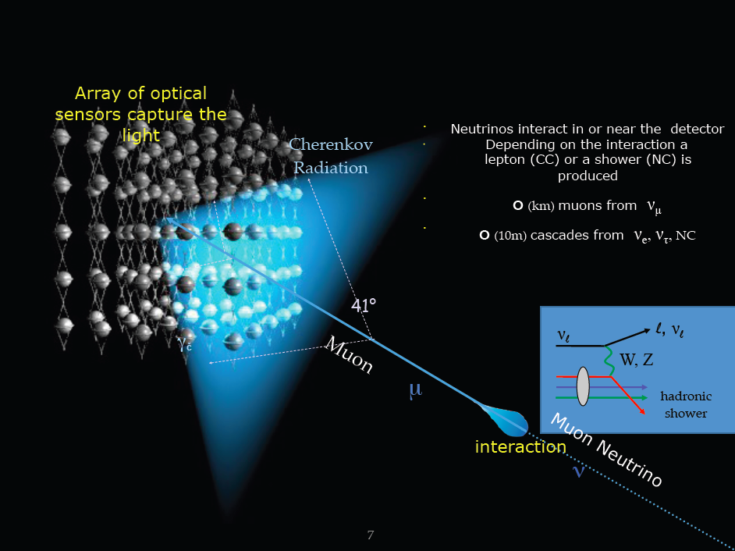
Water/ice Cherenkov detectors

Slide 8
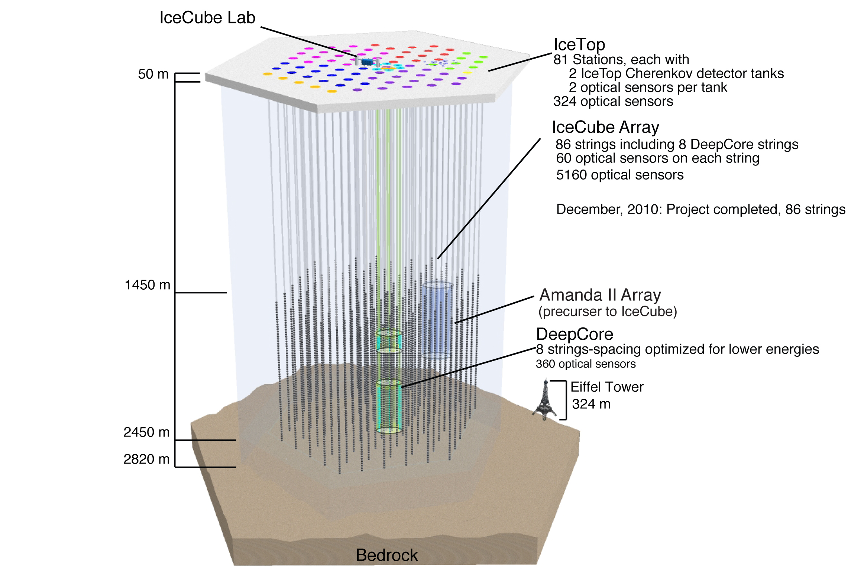
IceCube
Water/ice Cherenkov detectors: IceCube
Total of 86 strings and 160 IceTop tanks;
Completion with 86 strings: January 2011
Full operation with all strings since May 2011.
8

Slide 9
Water/ice Cherenkov detectors: Optical properties and noise characteristics
Add a few comments on water and ice

Slide 10
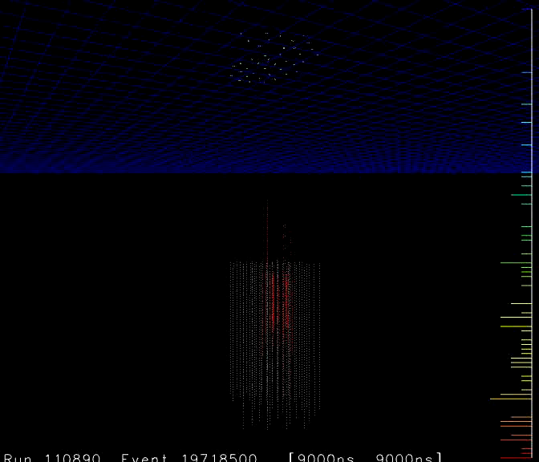
Air shower of ~3E17 eV
Observed by IceTop,
Then by Deep detector strings

Slide 11
Energy scales and future detectors - from low to high energy
1 – 100 GeV: IceCube extensions: PINGU and beyond, additional veto strategies
TeV – PeV plans for larger Water/ice Cherenkov detectors
  KM3Net
  Baikal upgrade
10 PeV – 10 EeV detectors:
  Radio Cherenkov detectors: ARA, ARIANNA, more ANITA flights, Auger horizontal

Slide 12

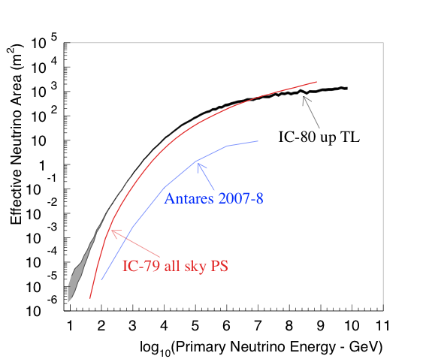
Water/ice Cherenkov detectors: Neutrino effective areas
Wide energy range due to increase in effective area!
Area at 100 TeV (1TeV)
IceCube 86: 40m² (0.3m²)
Deep Core lowers threshold from 100 GeV to 10 GeV.
Effective area for
Strong rise with energy:
  (up to 100TeV
  Increase of muon range with energy up to PeV
  Flattening above PeV energies.

Slide 13
Water/ice Cherenkov detectors: Neutrino effective areas
Wide energy range due to increase in effective area!
PINGU lowers threshold to
few GeV
Effective area for
Strong rise with energy:
  (up to 100TeV
  Increase of muon range with energy up to PeV
  Flattening above PeV energies.
Low energy extensions
to IceCube, DeepCore:
PINGU, MICA

Slide 14
Water/ice Cherenkov detectors: Neutrino effective areas
Wide energy range due to increase in effective area!
Projects with more PMT cathode area like KM3Net
would establish larger detectors in Northern hemisphere:
Not only size but optimal view to Galactic Center (Southern Hemispher)
TeV-PeV energy frontier:
Km3Net, Baikal GVD
Effective area for
Strong rise with energy:
  (up to 100TeV
  Increase of muon range with energy up to PeV
  Flattening above PeV energies.
Low energy extensions
to IceCube, DeepCore:
PINGU, MICA

Slide 15
Water/ice Cherenkov detectors: Neutrino effective areas
Wide energy range due to increase in effective area!
TeV-PeV energy frontier:
Km3Net, Baikal GVD
UHE energy detectors
for GZK neutrino flux:
ARA, ARIANNA
Radio detection in ice:
Detection volume increases roughly linearly with energy!
Low energy extensions
to IceCube, DeepCore:
PINGU, MICA

Slide 16
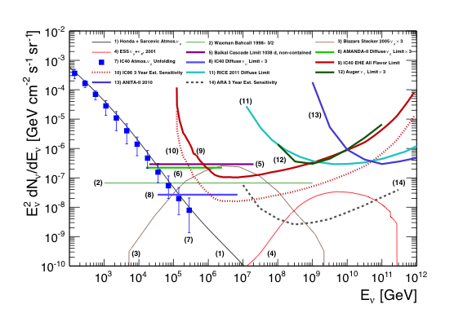
Diffuse fluxes
Neutrino fluxes: Measurements, predictions and upper limits
Notes:
Differential fluxes are shown as published, no corrections applied for bin sizes

Slide 17
The Neutrino Detector Spectrum
NOνA
Accelerator
OPERA
Atmosphericl
K2K,
T2K
MINOS
10 MeV
100 MeV
1 GeV
10 GeV
100 GeV
1 TeV
10 TeV
1 EeV
Astrophysical
Solar/Reactor
Atmospheric
IceCube/ANTARES ANITA/RICE/Auger/
KM3Net/Baikal GVD ARA/ARIANNA
Borexino/KamLand/Daya Bay/Double Chooz/SNO/SuperK
Non-accelerator based
Slide:
Courtesy Darren Grant
NNN 2011
* boxes select primary detector physics energy regimes and are not absolute limits

Slide 18
The Neutrino Detector Spectrum
NOνA
Accelerator
OPERA
K2K,
T2K
MINOS
Atmosphericl
10 MeV
100 MeV
1 GeV
10 GeV
100 GeV
1 TeV
10 TeV
1 EeV
Astrophysical
Solar/Reactor
Atmospheric
Gap
IceCube/ANTARES ANITA/RICE/Auger/
KM3Net/Baikal GVD ARA/ARIANNA
Borexino/KamLand/Daya Bay/Double Chooz/SNO/SuperK
Dark
Matter
Non-accelerator based
ντ
Appearance
νμ
Disappearance
Neutrino
Mass
Hierarchy
Slide:
Courtesy Darren Grant
NNN 2011
* boxes select primary detector physics energy regimes and are not absolute limits

Slide 19
The Neutrino Detector Spectrum
NOνA
Accelerator
OPERA
K2K,
T2K
MINOS
Atmosphericl
10 MeV
100 MeV
1 GeV
10 GeV
100 GeV
1 TeV
10 TeV
1 EeV
Astrophysical
Solar/Reactor
Atmospheric
DeepCore
Borexino/KamLand/Daya Bay/Double Chooz/SNO/SuperK
IceCube/ANTARES ANITA/RICE/Auger/
KM3Net/Baikal GVD ARA/ARIANNA
PINGU
beyond PINGU
Non-accelerator based
~70 active members in feasibility studies:
IceCube, KM3Net, Several neutrino experiments
Photon detector developers
Theorists
Slide:
Courtesy Darren Grant
NNN 2011
* boxes select primary detector physics energy regimes and are not absolute limits

Slide 20
IceCube-DeepCore
IceCube extended its “low” energy response with a densely instrumented infill array: DeepCore
Significant improvement in capabilities from ~10 GeV to ~300 GeV (νμ)
Scientific Motivations:
Indirect search for dark matter
Neutrino oscillations (e.g., ντ appearance)
Neutrino point sources in the southern hemisphere (e.g., galactic center)
http://arxiv.org/abs/1109.6096

Slide 21
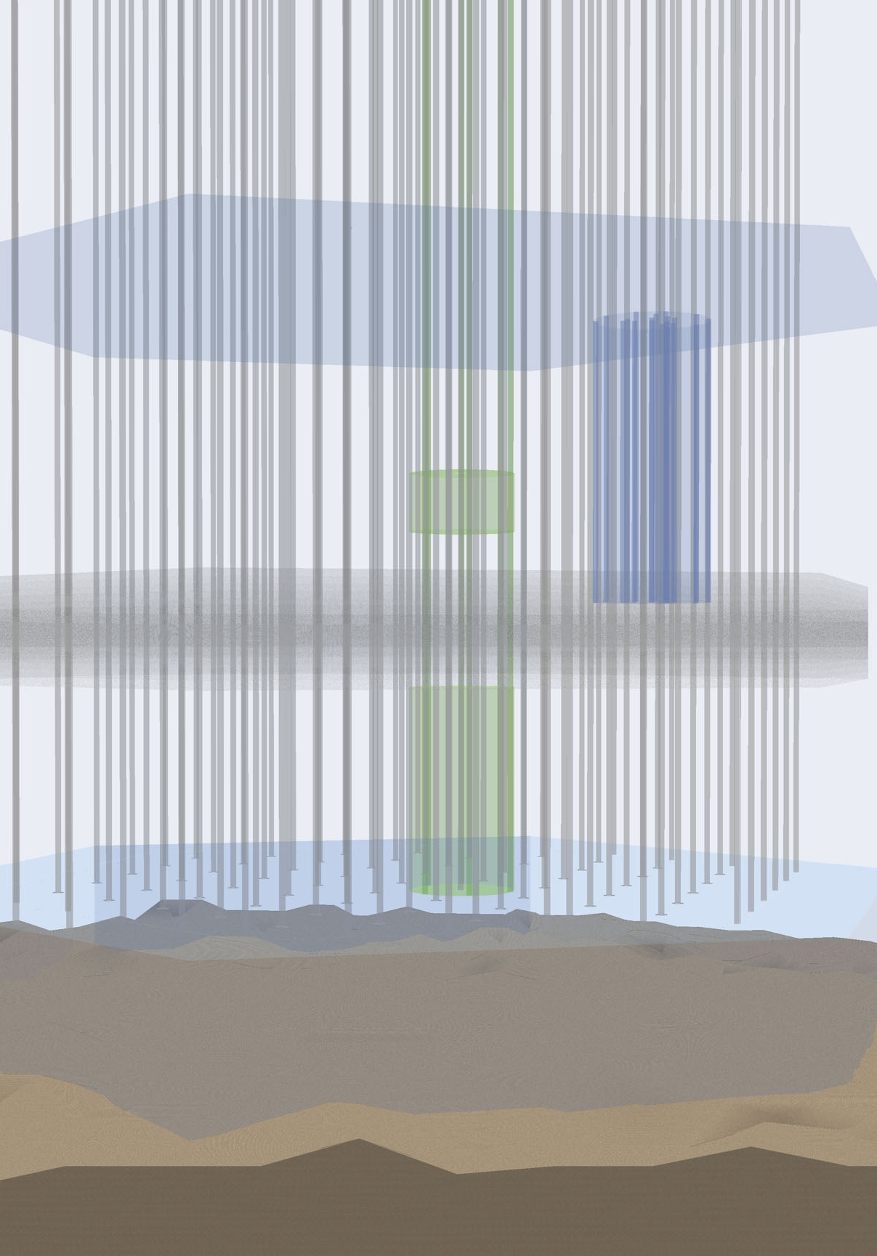
DeepCore: Design and Veto
Eight special strings in filled in the bottom senter of IceCube
~5x higher effective photocathode density than regular IceCube
Result: 30 MTon detector with
~10 GeV threshold, will collect
O(100k) physics quality atmospheric ν/yr
VETO
IceCube’s top and outer layers of strings provide an active veto shield for DeepCore
Effective μ-free depth much greater
Atm. μ/ν trigger ratio is ~10⁶
Vetoing algorithms expected to reach at least 10⁶ level of background rejection (effective muon flux after veto ~ similar to Sudbury.)
IceCube
extra
veto cap
AMANDA
350 m
Deep
Core
250 m

Slide 22
From Deep Core to PINGU
- Phased IceCube Next Generation Upgrade
A close look at neutrino events above ~10 GeV;
event identification and reconstruction possible.
  Science goals:
    improve WIMP search,
    neutrino oscillation measurements,
    other low energy physics, → e.g. mass hierarchy
See reports by the collaboration at this conference
Posters by
  A. Gross (IceCube coll.): atmospheric neutrinos in oscillation region
  yyyyyyyyyyyyyy (IceCube Coll.): PINGU
Figure from:
Akhmedov,
Razzaque,
Smirnov
arXiv: 1205.7071
1 5 10 15 20
[GeV]

Slide 23
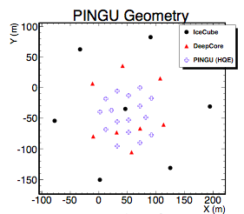
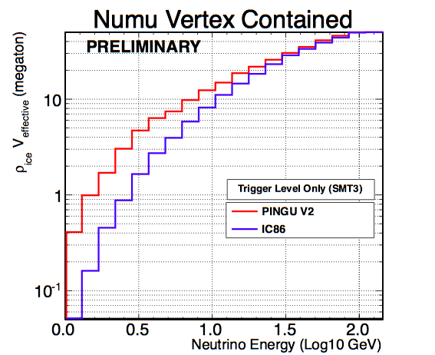
PINGU
PINGU geometry
(more compact version also studied)
Phased IceCube Next-Generation
Upgrade
Add 20 strings with ~1000 optical modules in
Deep Core region
Expected energy threshold at 1 GeV
R&D opportunity for future developments

Slide 24
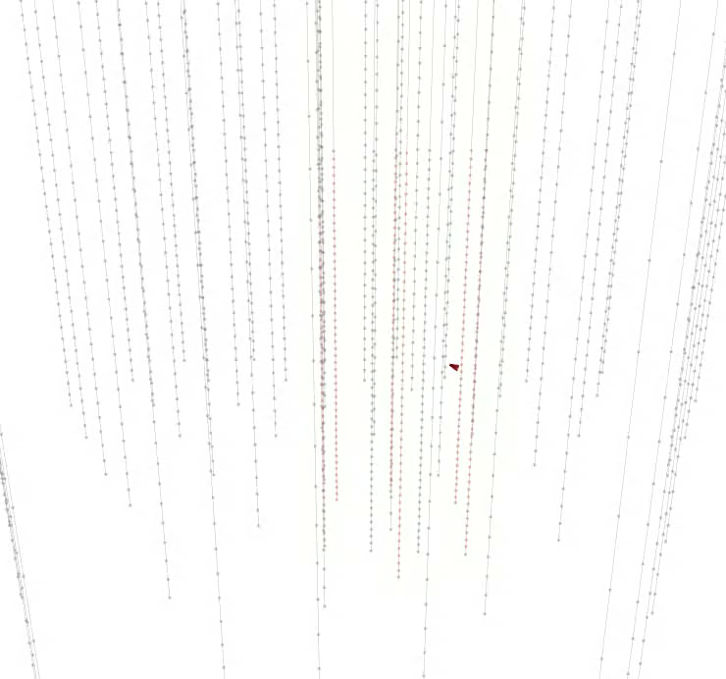
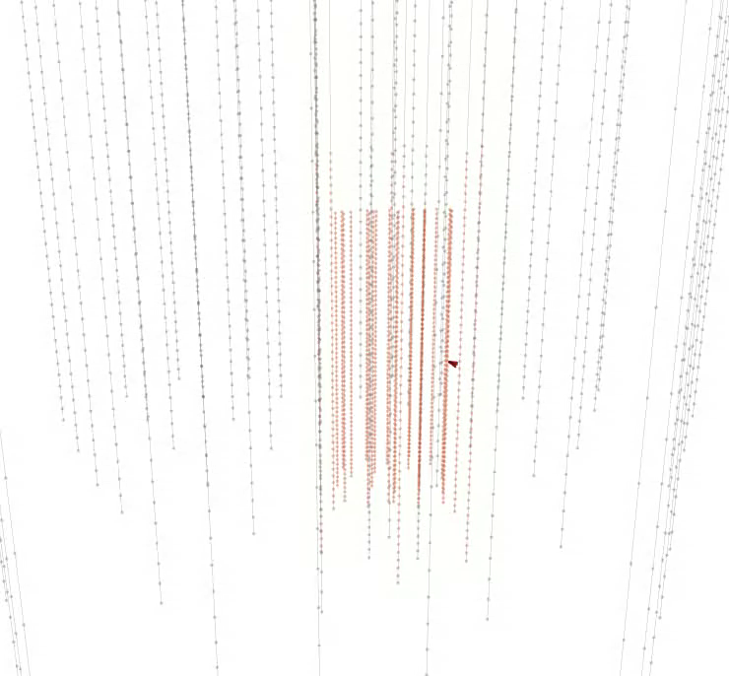
Simulated event in DeepCore and PINGU
DeepCore Only
9.28 GeV Neutrino, 4.9 GeV muon, 4.5 GeV cascade
Physics hits only, no noise
DeepCore + PINGU

Slide 25
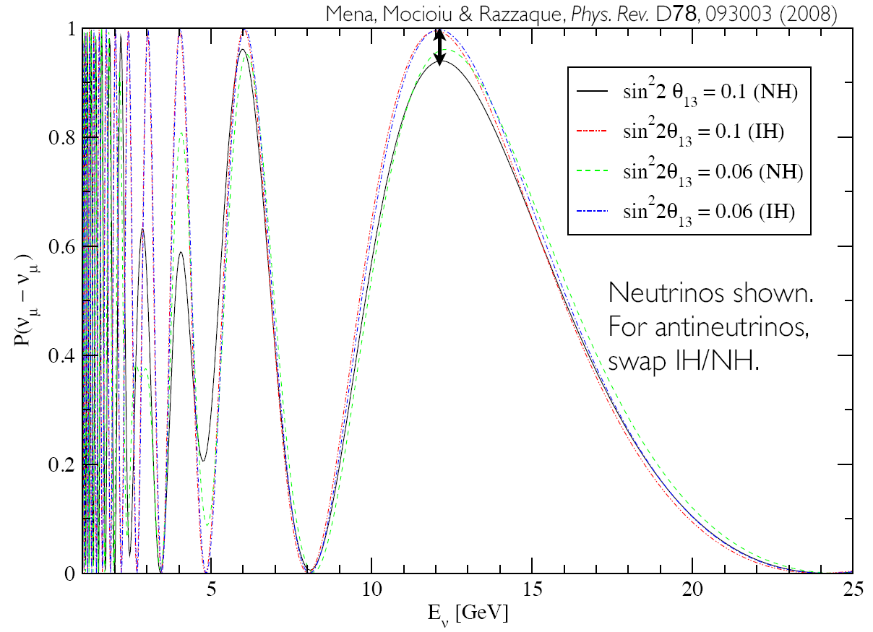
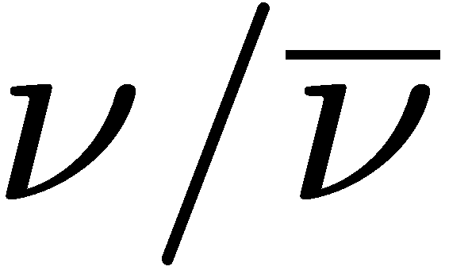


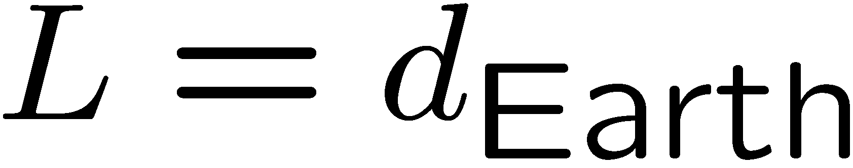
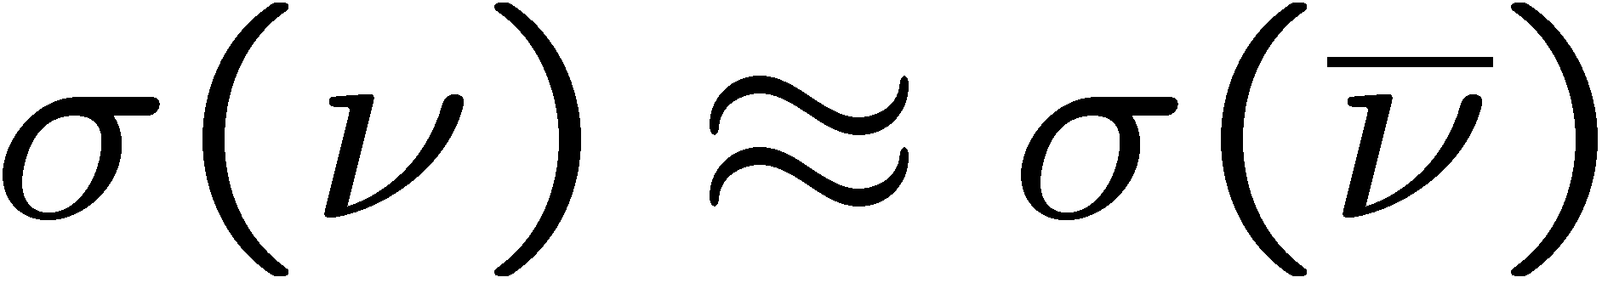
Mass hierarchy (atmospheric ν)
MSW effect in Earth induces difference
in oscillations
Note: first maximum
for is at
12 GeV for
Could be measurable since
at these energies
Advanced analysis:
“oscillograms”
(A. Smirnov)

Slide 26
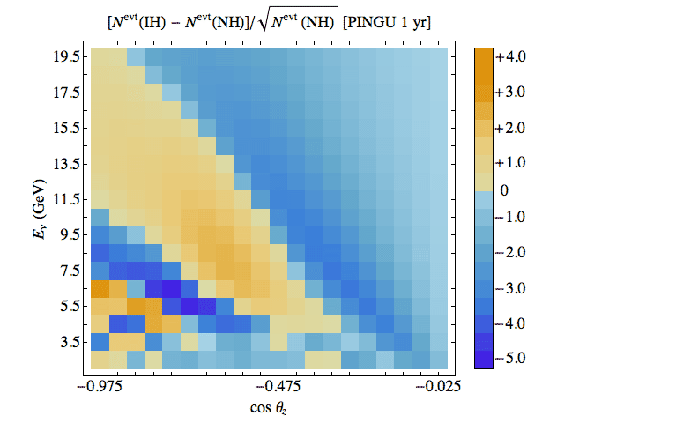
Mass hierarchy oscillogram
Figure and Analysis from:
Akhmedov, Razzaque, Smirnov
arXiv: 1205.7071
Expected signal
significance in
energy vs. zenith
If required energy
and directional resolution is achievable, → high statistics data
“Our preliminary estimates show that after 5 years of PINGU 20 operation the significance of the determination of the hierarchy can range from 3 to 11 (without taking into account parameter degeneracy), depending on the accuracy of reconstruction of neutrino energy and direction.”

Slide 27
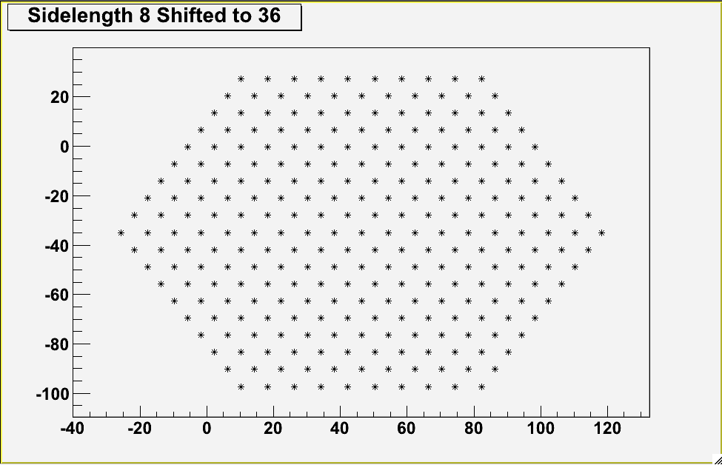
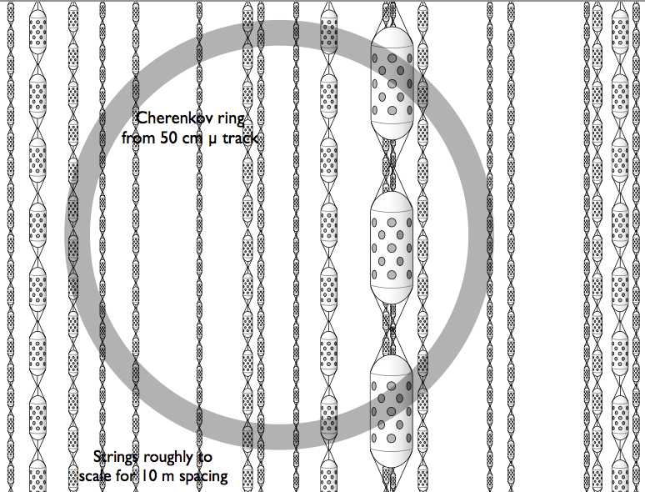
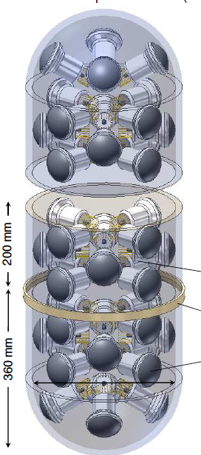
beyond PINGU Conceptual Detector
O(few hundred) strings of “linear” detectors within DeepCore fiducial volume
Goals: ~5 MTon scale with energy sensitivity of:
  O(10 MeV) for bursts
  O(100 MeV) for single events
Physics extraction from Cherenkov ring imaging in the ice
  Proton decay p -> π⁰ + e⁺
  Supernova to 5 Moc
Poster ay this conference
by L. Classen, O. Kalekin, U. Katz, P. Kooijman, E. de Wolf.

Slide 28
Mica animated event possibly here

Slide 29
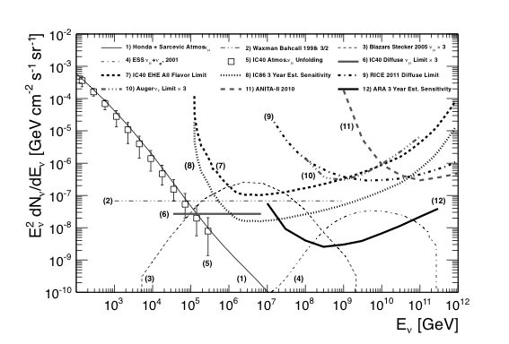
TeV to 10 PeV energy scale

Slide 30

KM³ Neutrino Telescope
The next generation neutrino telescope
in the Mediterranean

Slide 31
Scientific focus
Geographical location
  Field of view includes Galactic centre
Optical properties of deep-sea water
  Excellent angular resolution
Envisaged budget 220‒250 M€
  Large effective neutrino area
Observation of Galactic neutrino sources

Slide 32
Architecture
physics data
10 Mb/s
analyses
40‒100 km
real-time access
to data
neutrino detector
shore station
“All-data-to-shore”
1 Tb/s
start
stop
remote
operation
software filter
500 CPUs
control

Slide 33
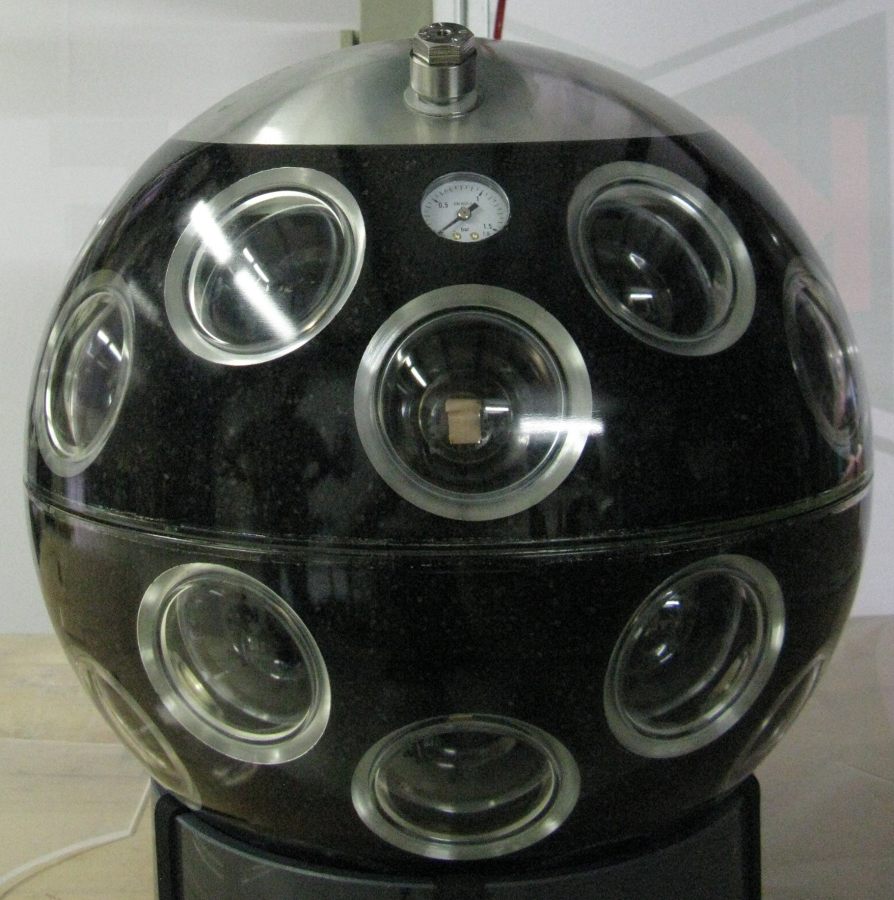
Multi-PMT optical module
31 x 3” PMTs
  larger than 3 x 10” PMTs
light collection ring
  20‒40% gain for free
low power HV circuit
  10 mW / PMT
calibration
  LED and piezo inside glass sphere
FPGA readout
  sub-ns time stamping
fibre-optic modulator
  no lasers off-shore
17 inch

Slide 34

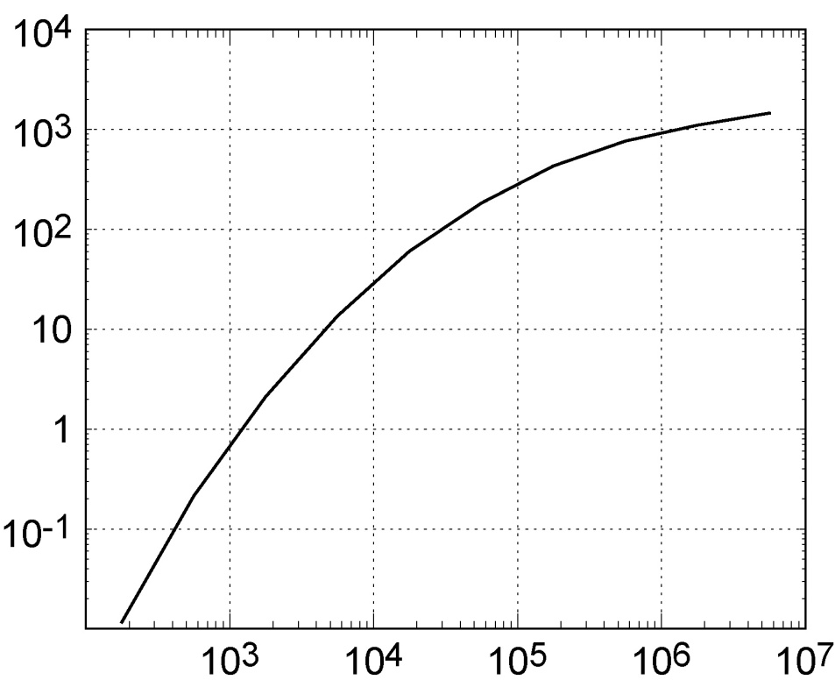
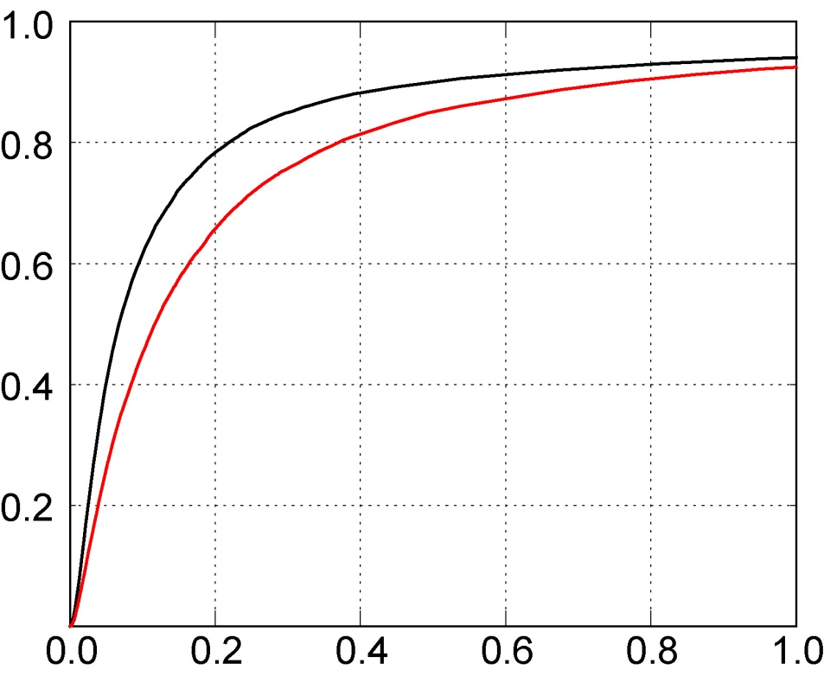
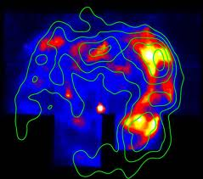
Performance
Effective neutrino area
Angular resolution
Area [m²]
Probability
muon
neutrino
RXJ 1713
E_{ν} [GeV]
Angle [degrees]
Supernova remnants as “origin of cosmic rays”
KM3NeT can make 5 (3) sigma discovery in 5 (2.5) years

Slide 35
Status
Science case
  discovery potential for Galactic sources
  provides for independent observation of a possible discovery by IceCube with improved significance within reasonable amount of time
  continuous and long-term measurements in the areas of oceanography, geophysics and marine biological sciences
Antares proved feasibility of (high-energy) neutrino astronomy in Mediterranean Sea
  see presentation P. Coyle at this conference
Major investments paved the way for KM3NeT
  site preparations, shore stations, ROV, assembly lines, prototyping, logistics, ...
Planning
  start capital of 40 M€ available
  deployment of first multi-PMT optical module this summer at Antares site
  first phase of construction will start later this year in Italy and France
  complete construction by 2020; siting and speed subject to future funding

Slide 36
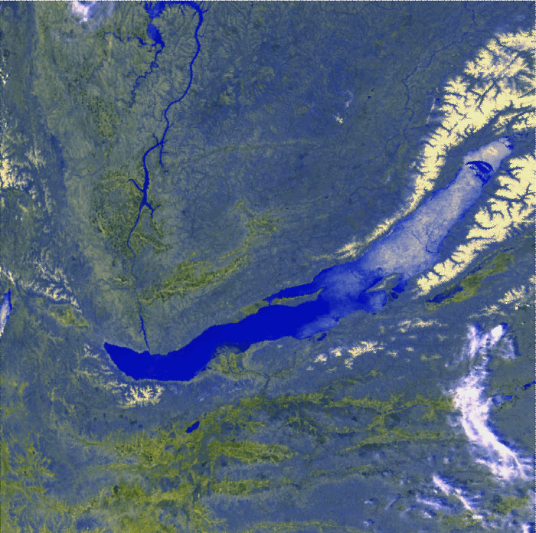
GVD – a km3 Neutrino Telescope
in Lake Baikal
Zh.-A. Dzhilkibaev, INR (Moscow),
for the Baikal Collaboration
Dubna, 8 December, 2011

Slide 37

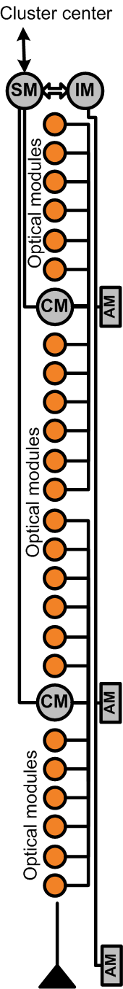
BAIKAL-GVD (minimal configuration)
Layout
96 Strings × 24 OM
String: 2 Sections × 12 OM
Clusters → 8 strings
2304 Optical Modules in total
12 clusters of strings
Optimization results
Z = 15 m – OMs spacing on strings
R = 60 m – the Cluster radius
H = 300 m - the distance between Clusters.
Trigger conditions
Hardware trigger: coincidences of nearby OMs
(threshold 0.5&3 p.e.). Software selection: muons – 6 triggered channels at 3 strings; cascades – 4 channels at 3 strings.
Effective cascade volume (E > 50 TeV):
V_{eff} ~0.3–0.7 km³ , δ(lgE) ~0.1, Δθ_{med}~ 5º
Effective muon area (E >3 TeV ):
S_{eff} ~ 0.2 – 0.8 km², Δθ_{med} < 0.5º
L~ 350 m
String section, 12 OMs
R ~ 60 m

Slide 38
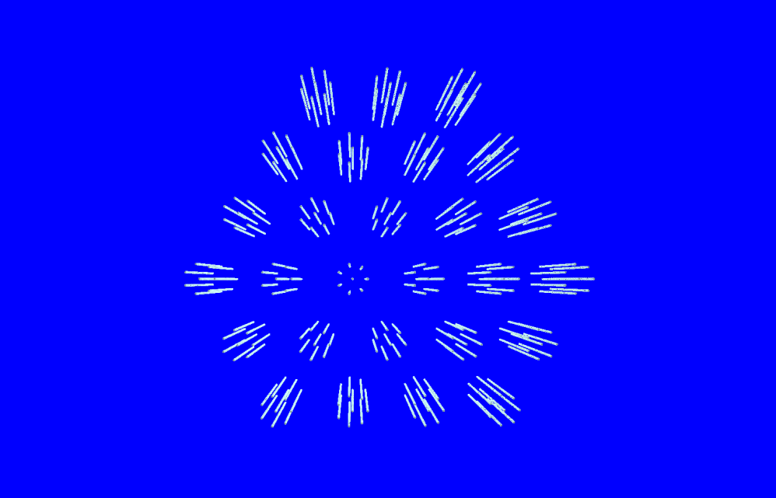
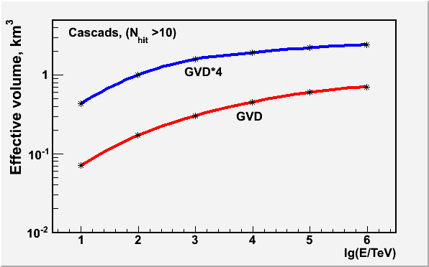
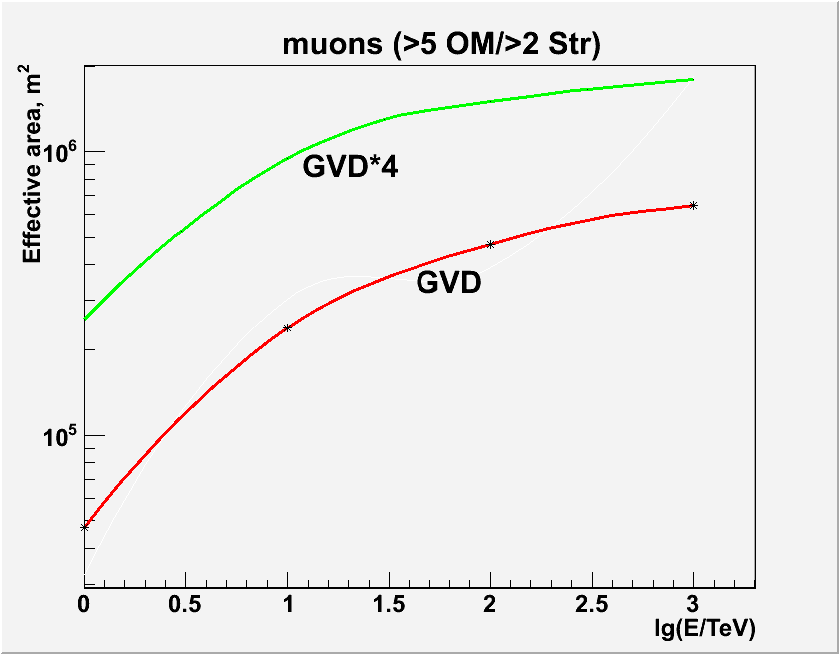

GVD$∗4$
Instrumented volume: 1.5 km³
Depth: 600-1300 m (705 m long strings)
10368 Optical Modules,
216 Strings: 48 OM/Str, 3 Sec./Str
27 Clusters.: 8 Str/Cluster
Cascades: (E>10 TeV):
V_{eff} ~0.4–2.4 km³
Muons: (E>1 TeV):
S_{eff} ~ 0.3–1.8 km²
10368 OMs
10368 OMs
2304 OMs
2304 OMs

Slide 39
The cosmic energy frontier: Cosmogenic, GZK neutrinos
Need detection rates such that the the normalization of the GZK neutrino flux can be reliably determined.
That requires more than 100 times better sensitivity than published results and more than 10 times the sensitivity of IceCube at 1E18 eV.
Alternatives to water/ice based optical Cherenkov detectors:
  Radio detection in the Antarctic ice
Future experimental goals
ARA:
Location: South Pole
Area: 150 – 200 km2
embedded detector
Ice sheet: 2.8 km
Prototype array in installation
ARIANNA:
Location: Ross Ice Shelf
Area: 1000km2
Shelf thickness: 600m
Surface detctor

Slide 40
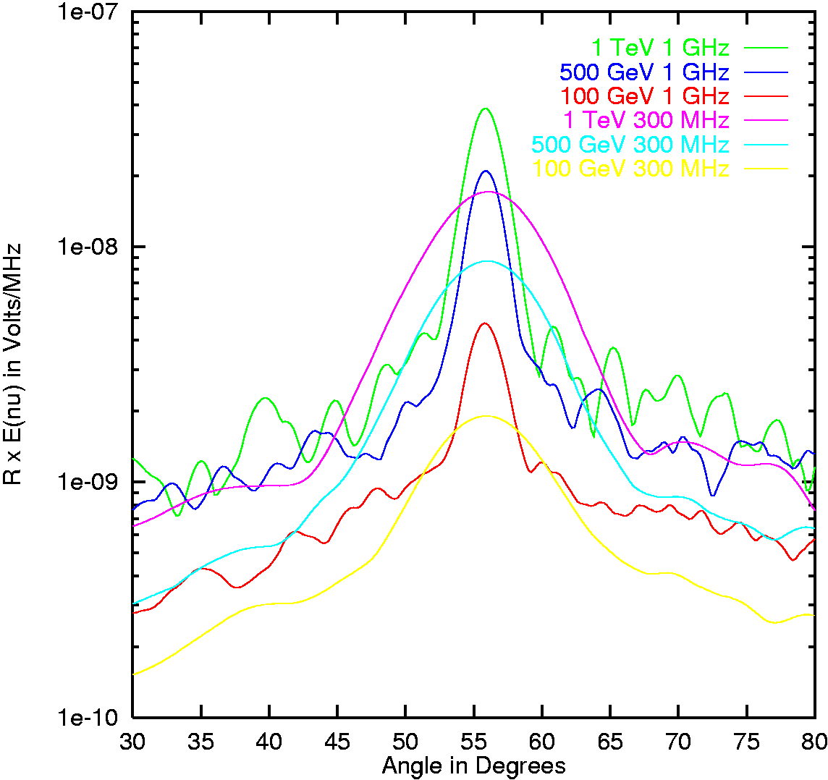
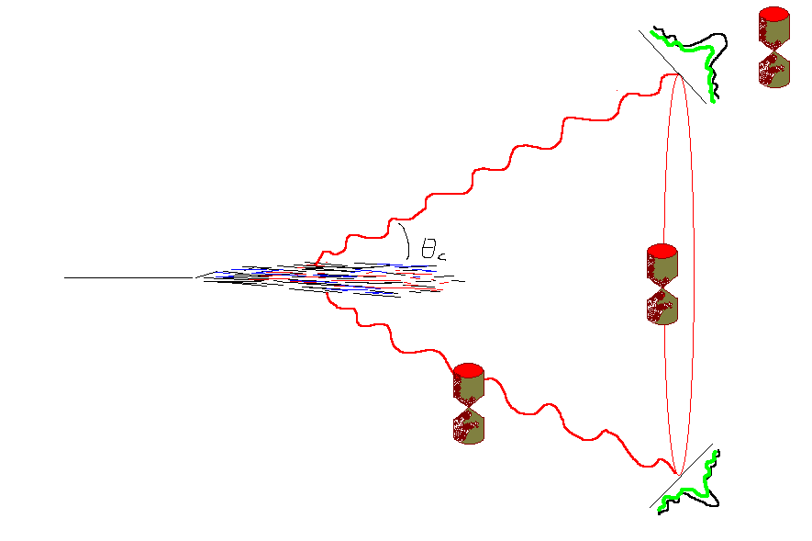
Detection principle:
Coherent radio emission from e.m. cascade
Gurgen Askaryan, 1960ies
charge asymmetry in particle shower development produces a net charge of cm extension.
→ coherent radio emission from c > c_medium moving charge
cone narrows for higher frequencies - analogous to single slit diffraction
Add coherently!
Notes:
The emission of a coherent radio signal comes from the charge asymmetry in particle shower development. The asymmetry is due to combined effects of positron annihilation and Compton scattering on atomic electrons. There is a 20% excess of electrons over positrons in a particle shower, which moves as a compact bunch, a few cm wide and ~1cm thick, at a velocity above the speed of light in the medium. The frequency dependence of Cherenkov radiation emitted is dP proportional to nu dnu. For radiation with wavelength lambda much greater than l, where l is the length scale of the bunch, the radiated electric field will add coherently and thus be proportional to the square of the shower energy. A radio signal emitted by a particle shower in a dielectric material such as ice or salt is coherent up to a few GHz, is linearly polarized, and lasts less than a nanosecond. A shower with energy less than 10^19 eV interacting in ice will produce a peak strength of ~1mV/m/Mhz at the distance of 1 km.

Slide 41
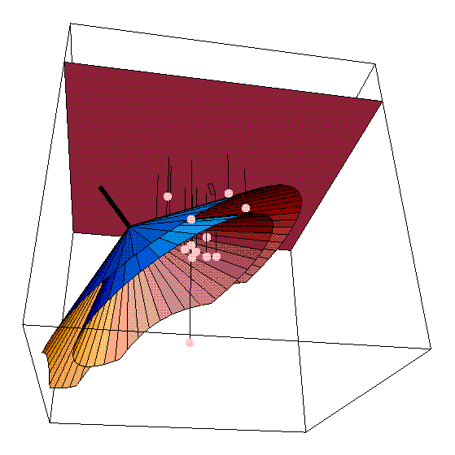
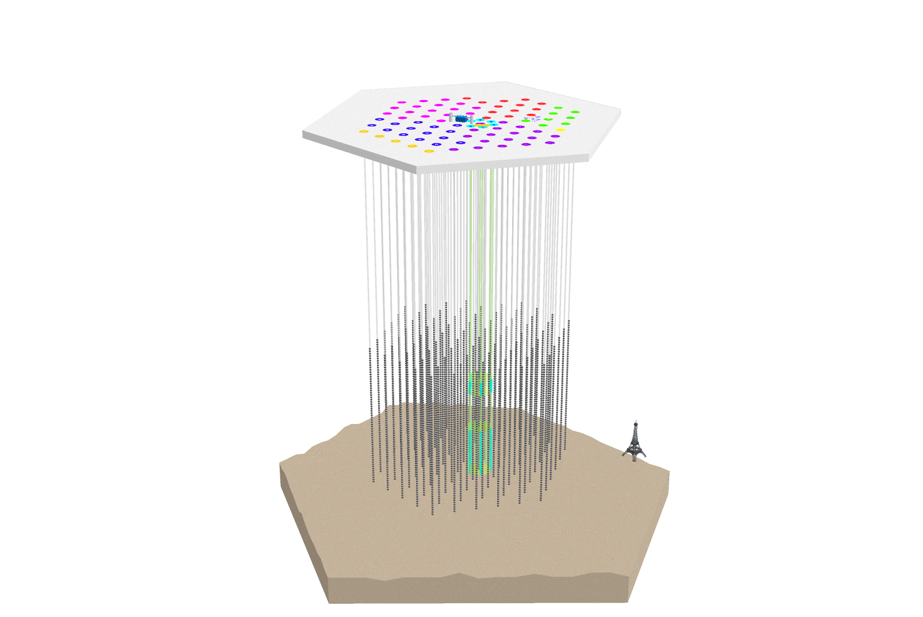
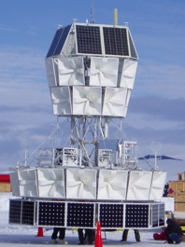

Existing and previous instruments using
radio in Polar ice
Experiences for ARA, Collaborators from all three experiments joined ARA
RICE
Special instruments
In IceCube
(AURA, NARC)
ANITA
array of single dipole antennas deployed between 100 and 300m near the Pole
much of the instrumentation was deployed in AMANDA holes
Pioneered technique in the ice
balloon payload of horn antennas
surveys the ice cap from high altitude for RF refracted out of the ice

Slide 42
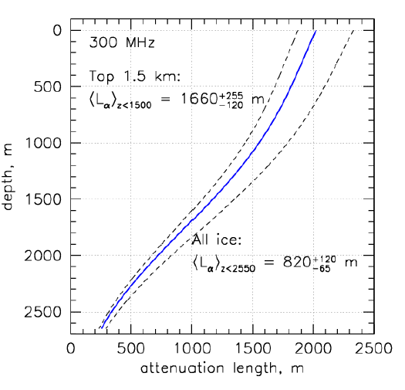
South Pole glacial ice – 2.8km, cold and RF transparent
Thickness: 2800m
Temperature: -55°C at top, -40°C at 1500m
Attenuation length at 300MHz: ~ 1.5km at depths < 1500m.
  → Slightly better than expected
Very low electromagnetic noise
depth/m
0
500
1000
1500
2000
2500
Tetsbed data for
this measurement

Slide 43
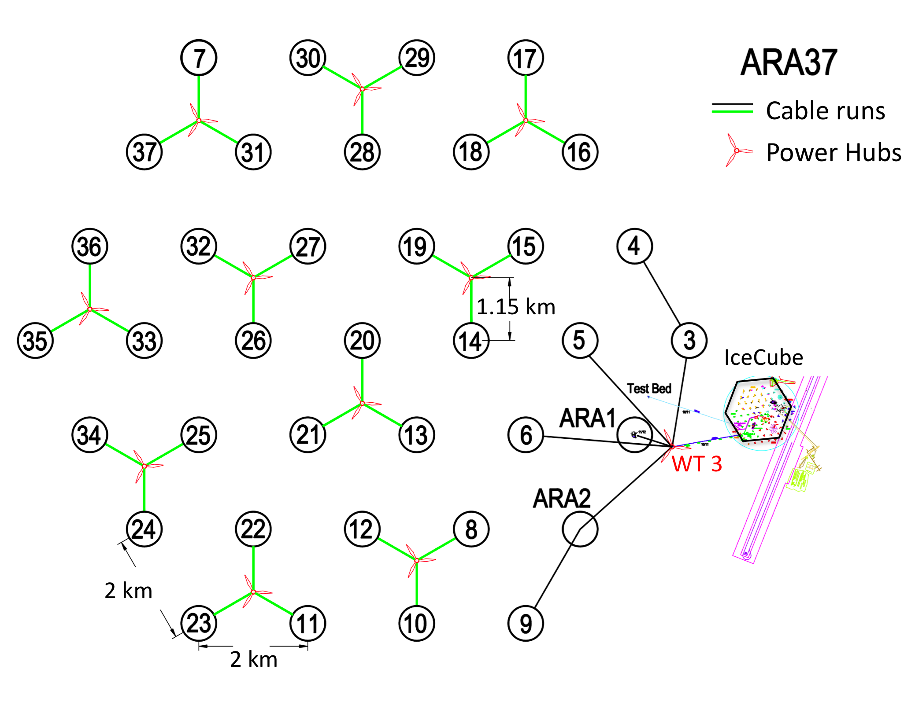
Askaryan Radio Array (ARA)
- a very large large radio neutrino detector at the South Pole
Poster session at this conference:
→ H. Landsman, ARA Design and Status
→ J. Davies, ARA prototype and first station
Scientific Goal
Discover and determine the flux of highest energy cosmic neutrinos.
Understanding of highest energy cosmic rays, other phenomena at highest energies.
Method:
Monitor the ice for radio pulses generated by interactions of cosmic neutrinos with nuclei of the 2.8km thick and radio transparent ice sheet at the South Pole
Areal coverage: ~150km^2

Slide 44
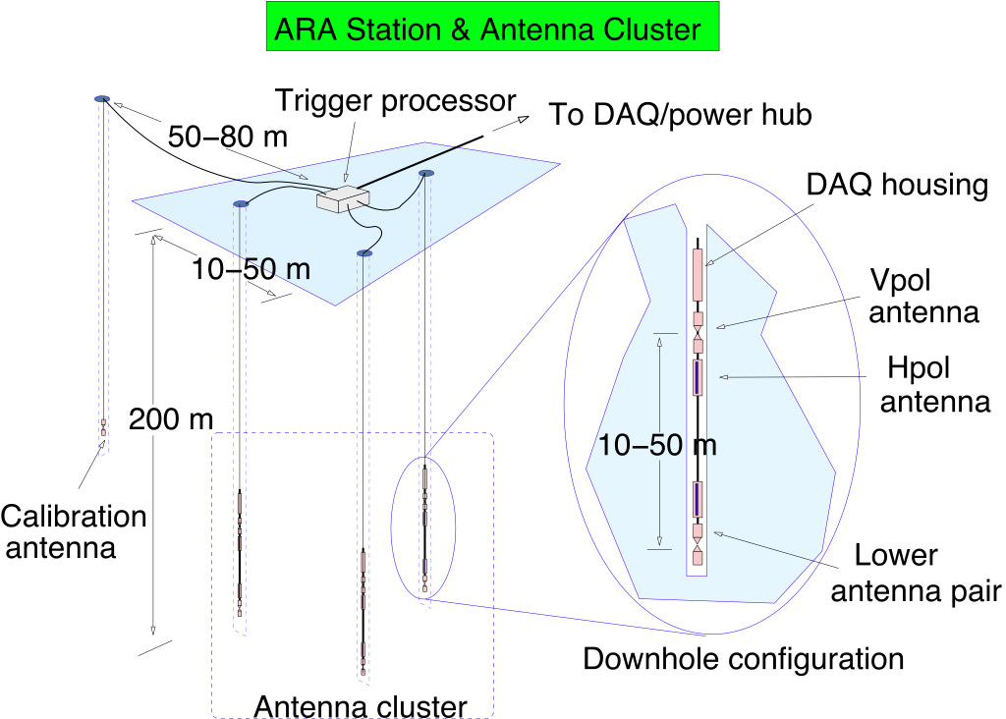
ARA station geometry
Design goals and choices:
Every station is a fully functioning detector.
→ Lower energy threshold: nearby events (300m) can be reconstructed.
Background rejection:
Embedded strings: Allow good vertex resolution and high vertical resolution for background rejection
Depth at 200m: below firn, Increase acceptance (factor 1.5 compared to 100m).

Slide 45
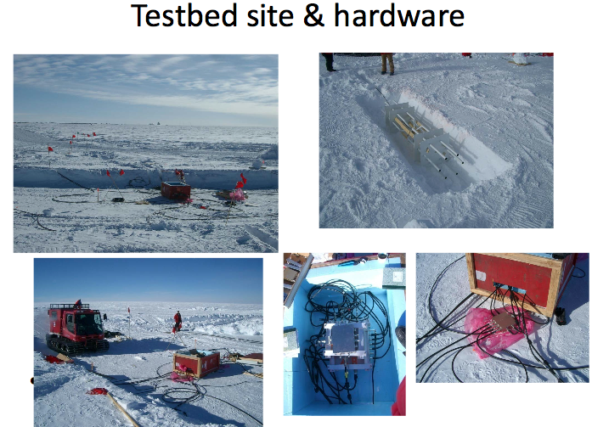
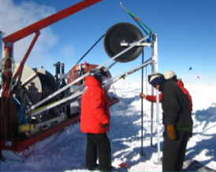
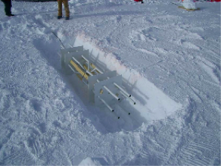
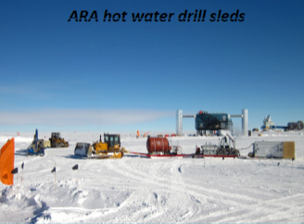
ARA field activities on the ice

Slide 46
ARIANNA

Slide 47
10^16 – 10^20 eV energy scale

Slide 48
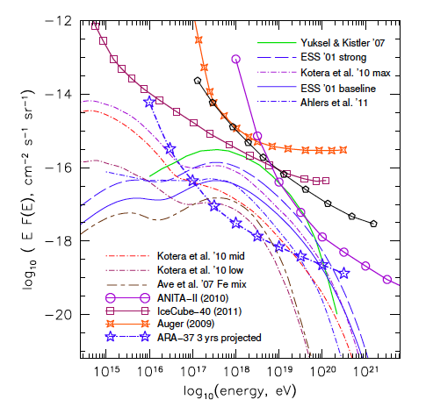
Search for cosmogenic (GZK) neutrino flux
3 years of IceCube has a good chance of seeing a few events.
→ A larger detector and different technology is needed to have good prospects of measuring this flux!
IceCube 3 year sens. (est.)
all flavor limits with ν_{e}:ν_{μ}:ν_{τ}=1:1:1

Slide 49
Summary
Big quantum leap in sensitivity with the realization of IceCube.
Future detectors on three energy scales with different science goals
  GeV energies: PINGU precision atmospheric neutrino physics with multi Mton target
  TeV to PeV energies: Projects with goals to expand sensitivity overall and especially towards Southern hemisphere, eg Galactic Center
  100 PeV to 100 EeV: Radio Cherenkov neutrino detectors using Antarctic Ice are inprototype/ 1st phase to detect cosmogenic neutrino flux
    ARA, a full large radio array (150km^2) for highest energy (GZK) neutrinos will surpass IceCube substantially in sensitivity with scalable technology.
    Very realistic chance to clarify cosmogenic neutrino flux level.

Slide 50
Acknowledgments
Thanks to
  M. DeJong, U. Katz, S, Barwick, Ch. Spiering, and many of my IceCube and ARA collaborators for useful discussions and materiels.

